Slide 1
Memorial Day
Thank you, U.S. veterans.
We remember
your sacrifices.

Slide 2
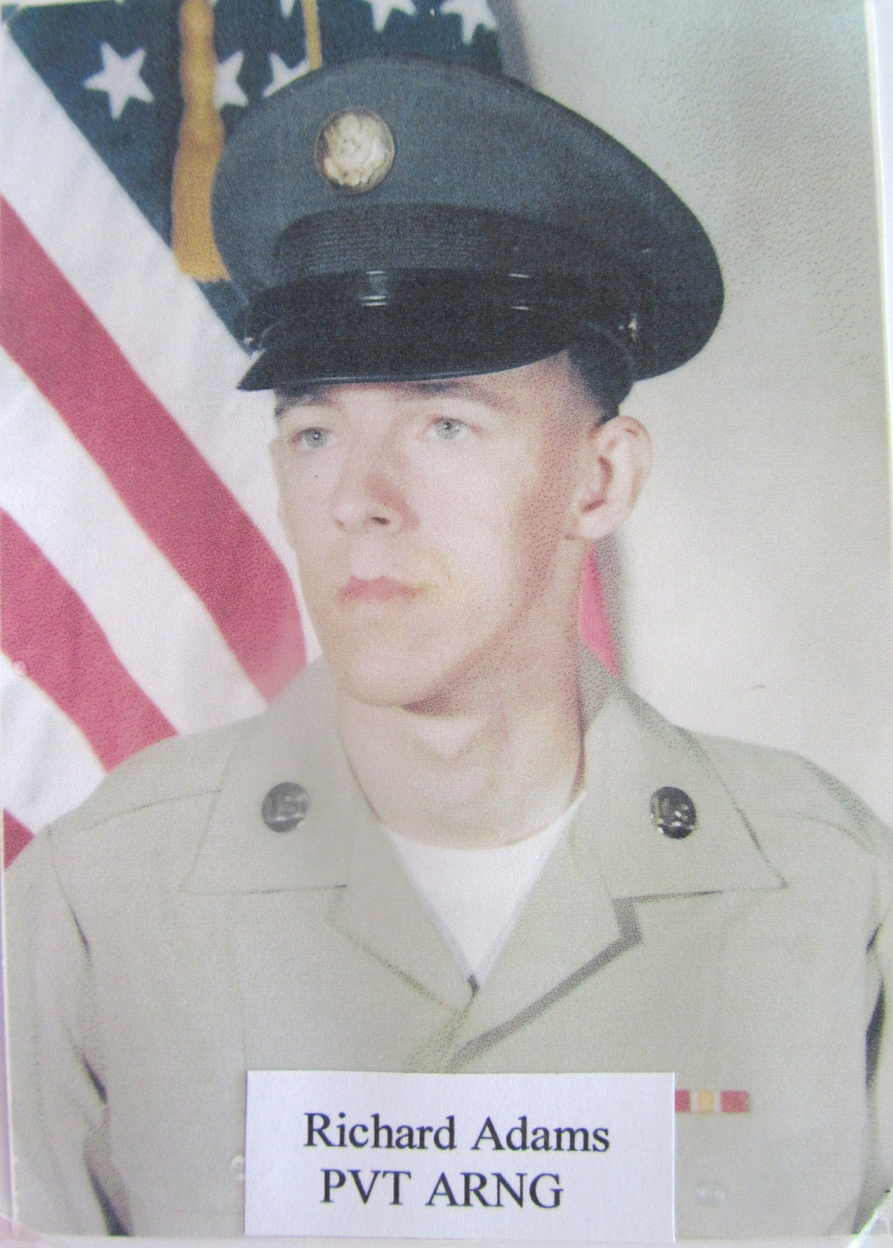

Slide 3
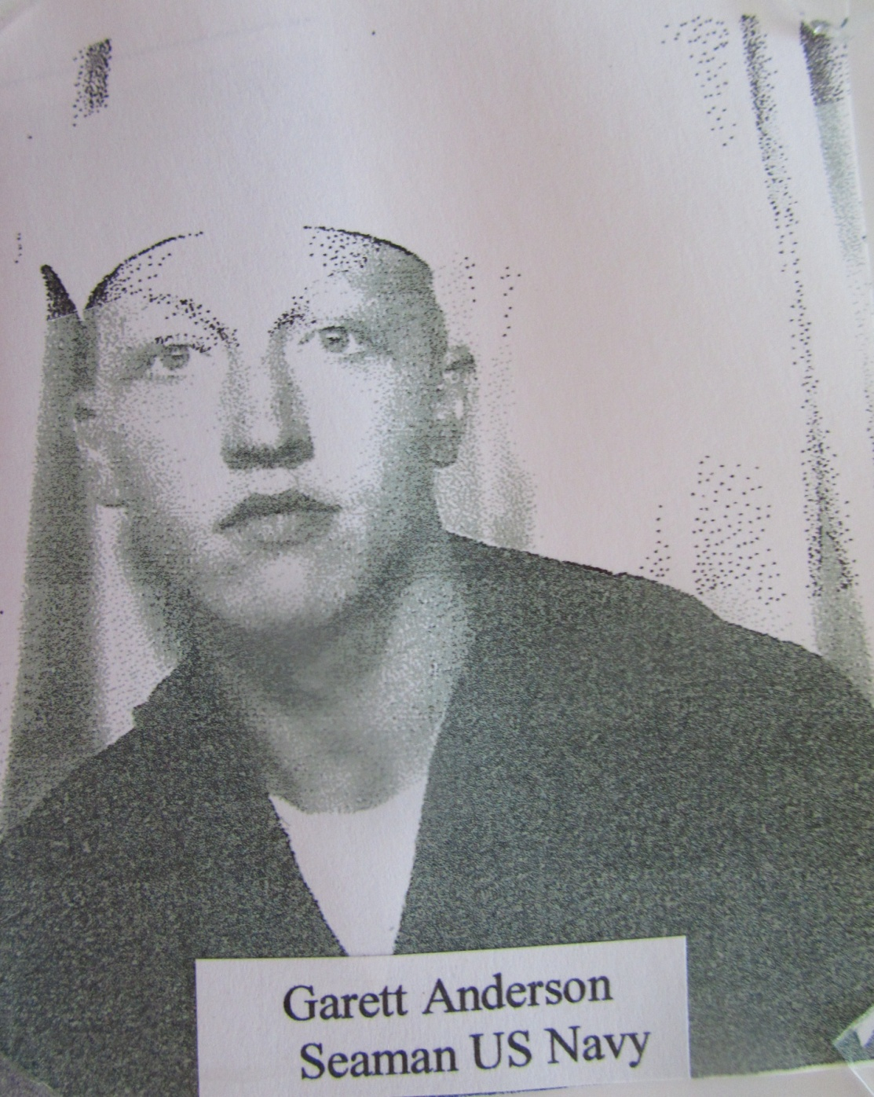

Slide 4
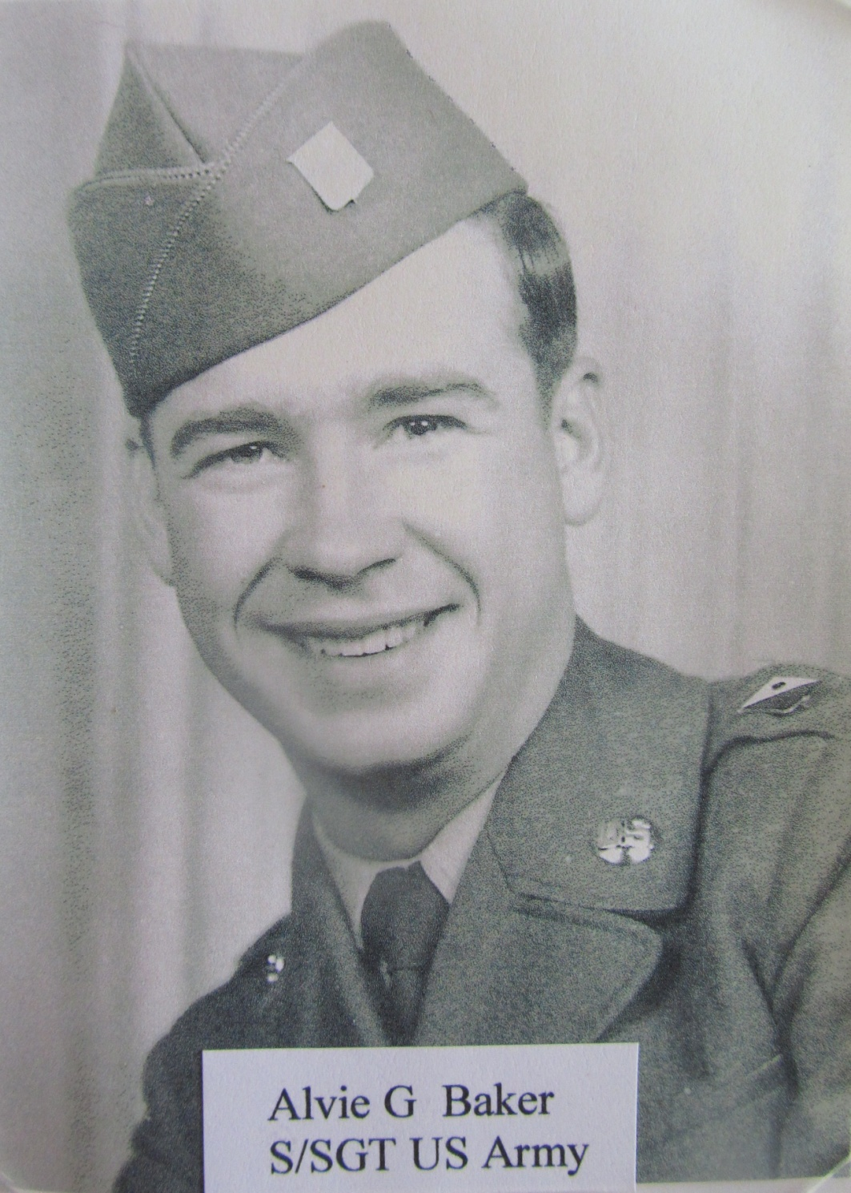

Slide 5
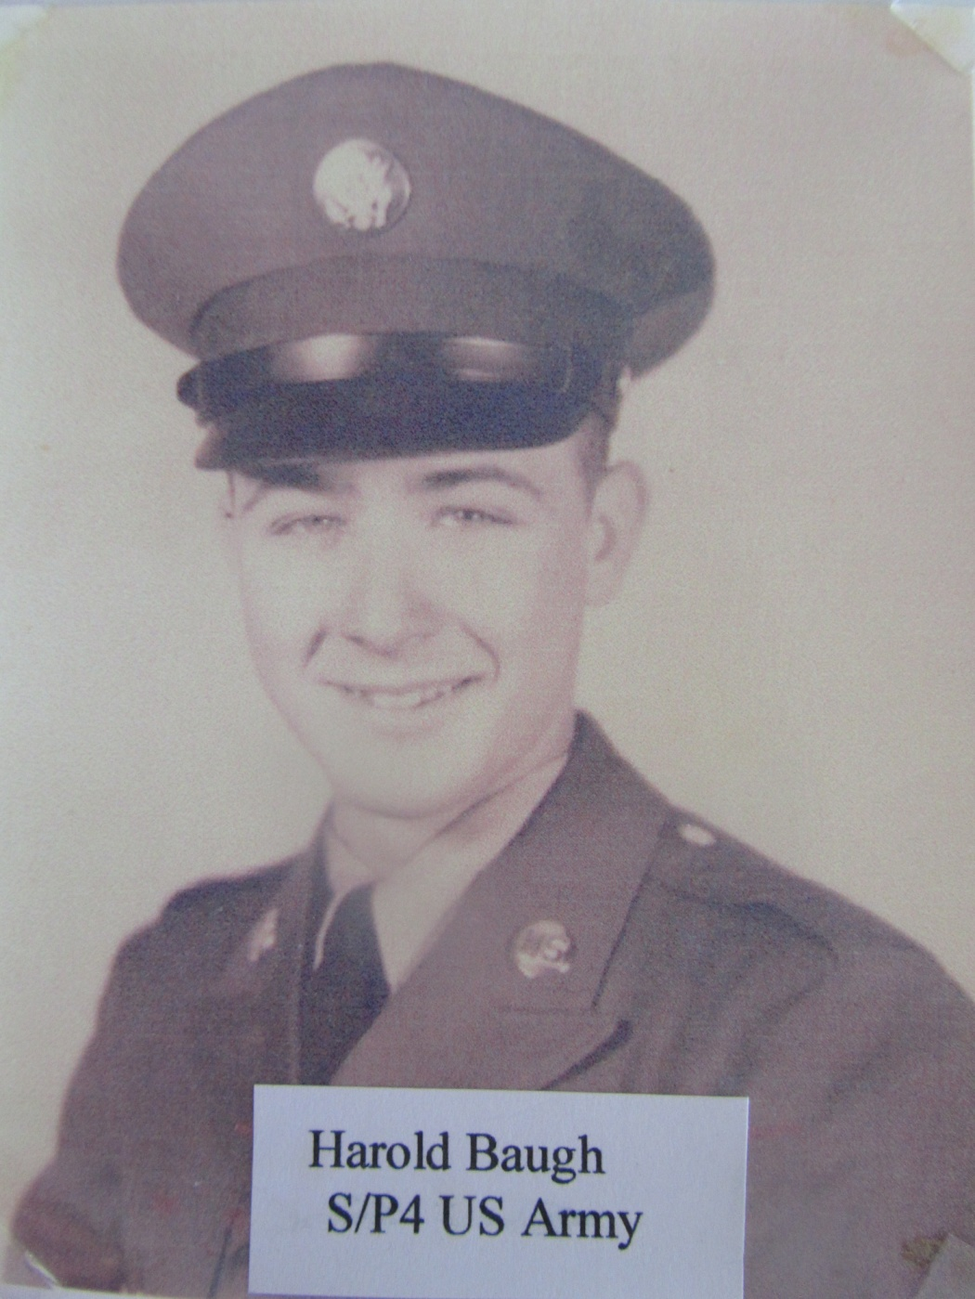
Harold Baugher

Slide 6
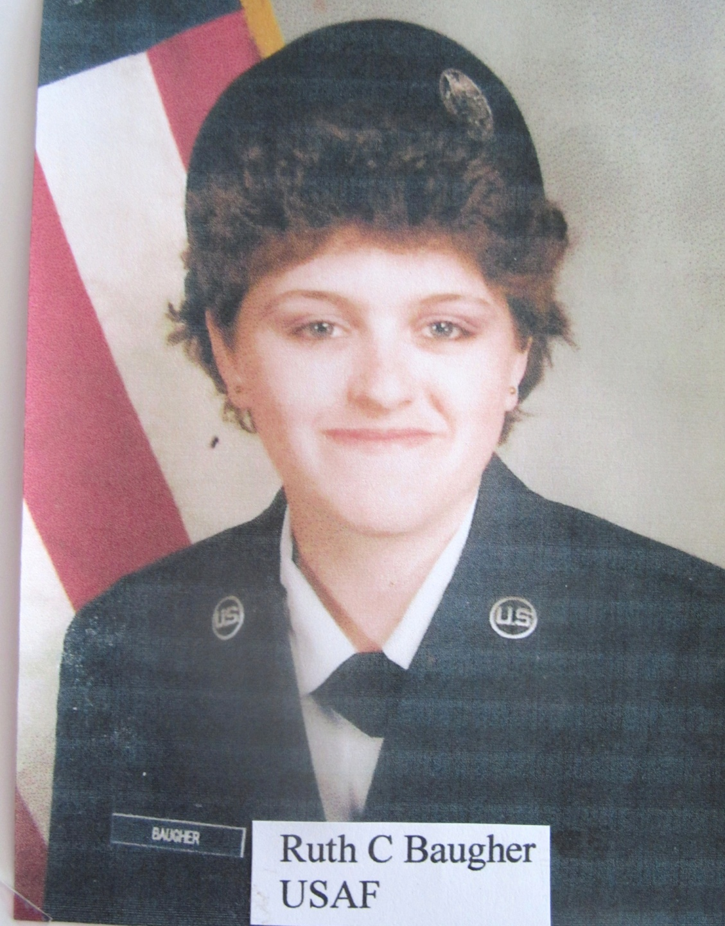

Slide 7
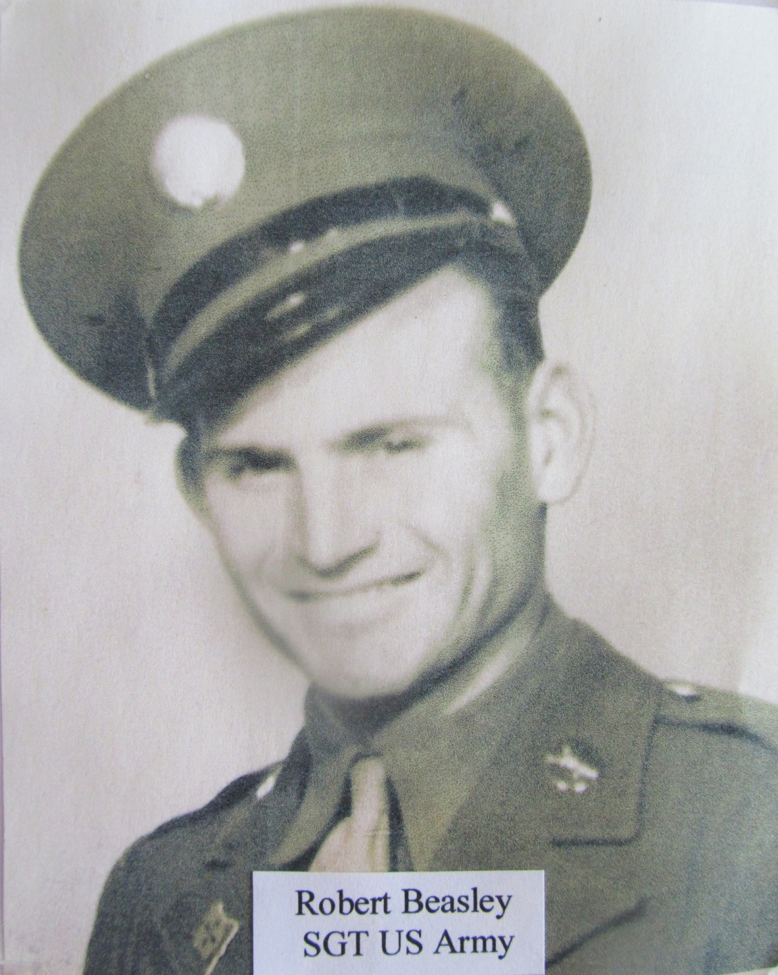

Slide 8
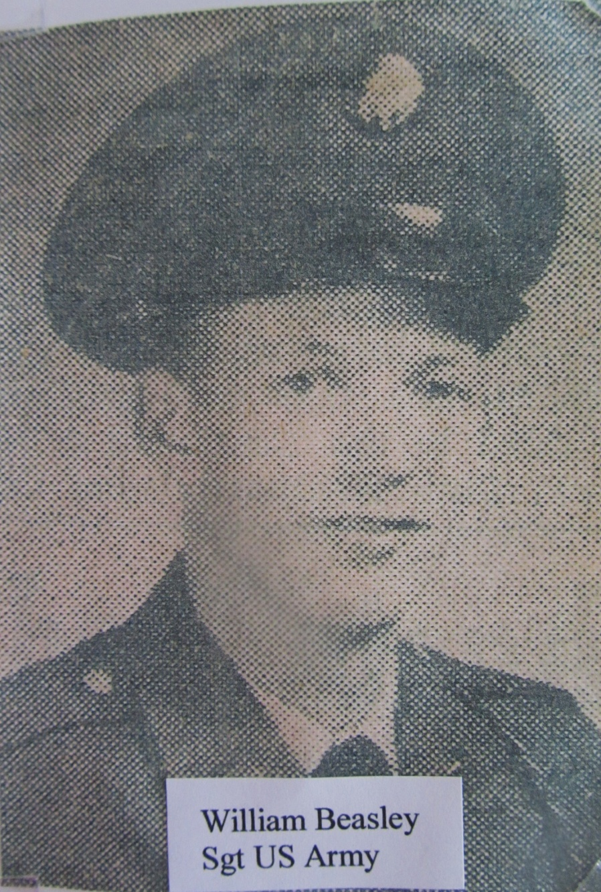

Slide 9
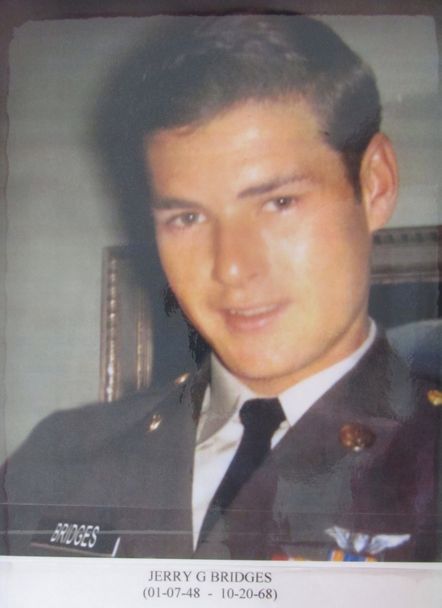
Jerry G. Bridges
Vietnam War

Slide 10
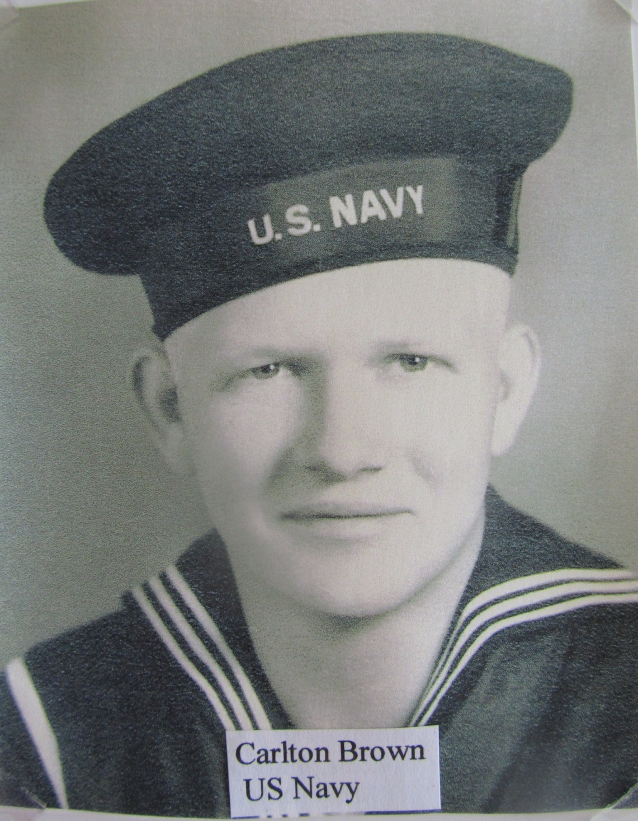

Slide 11
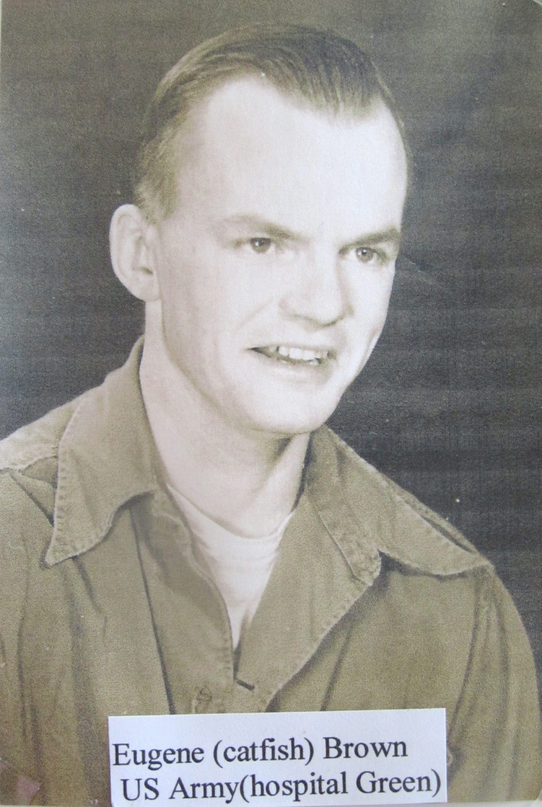

Slide 12
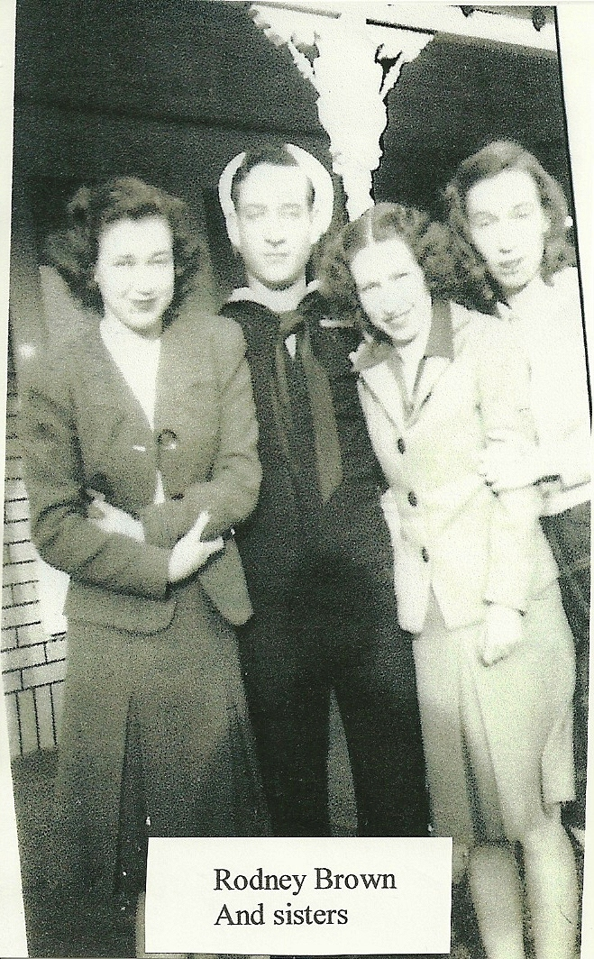

Slide 13
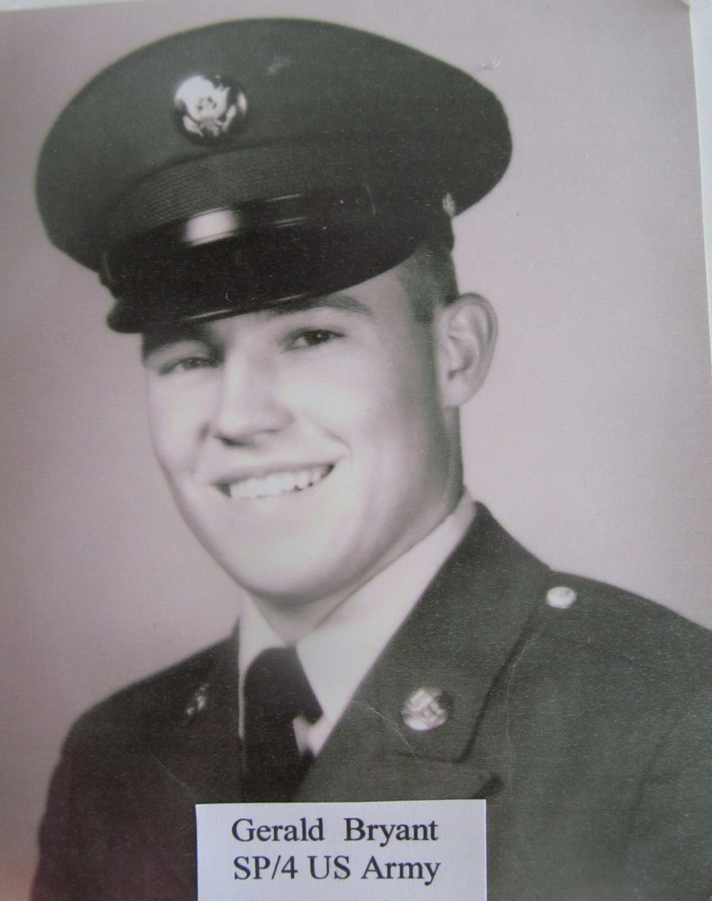

Slide 14
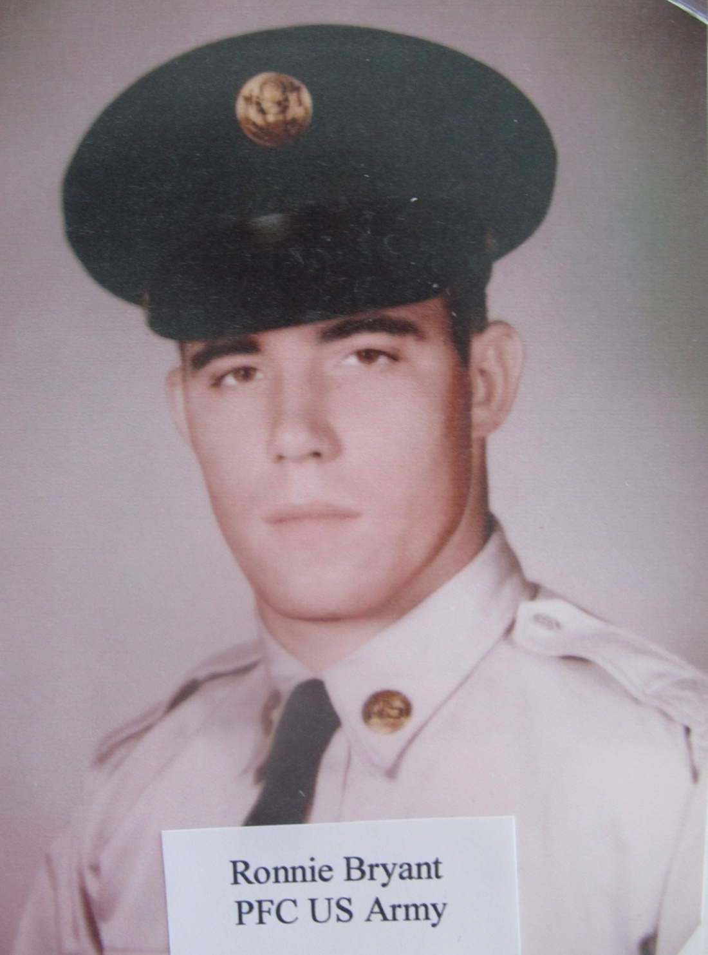

Slide 15
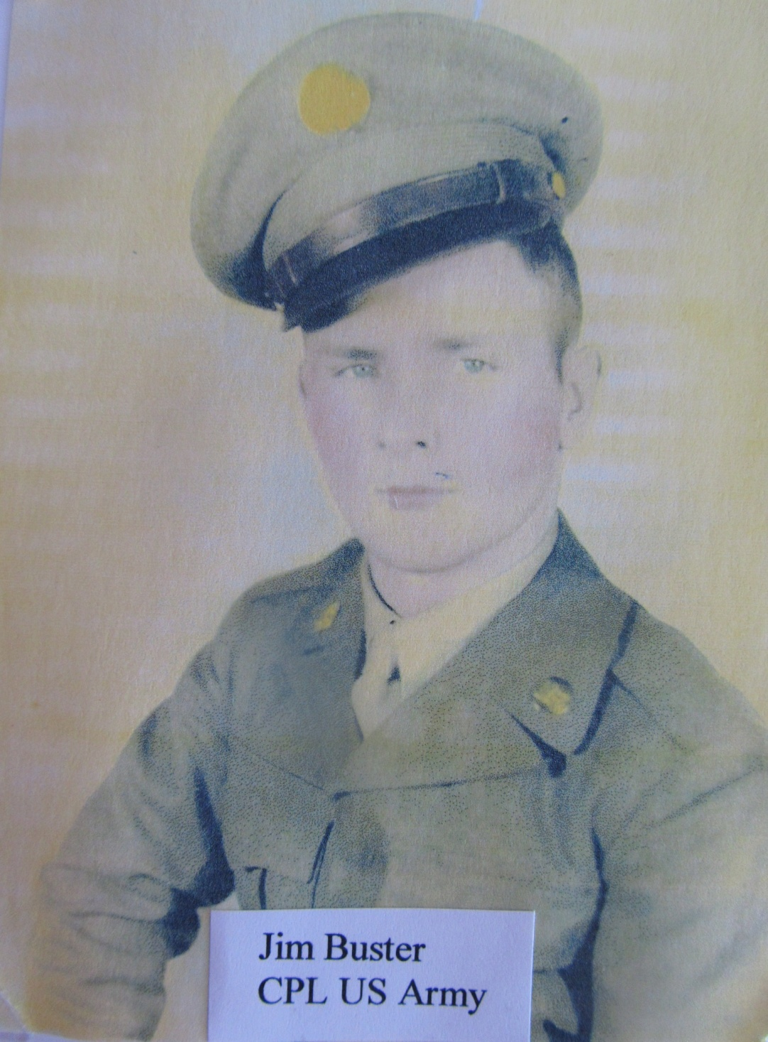

Slide 16
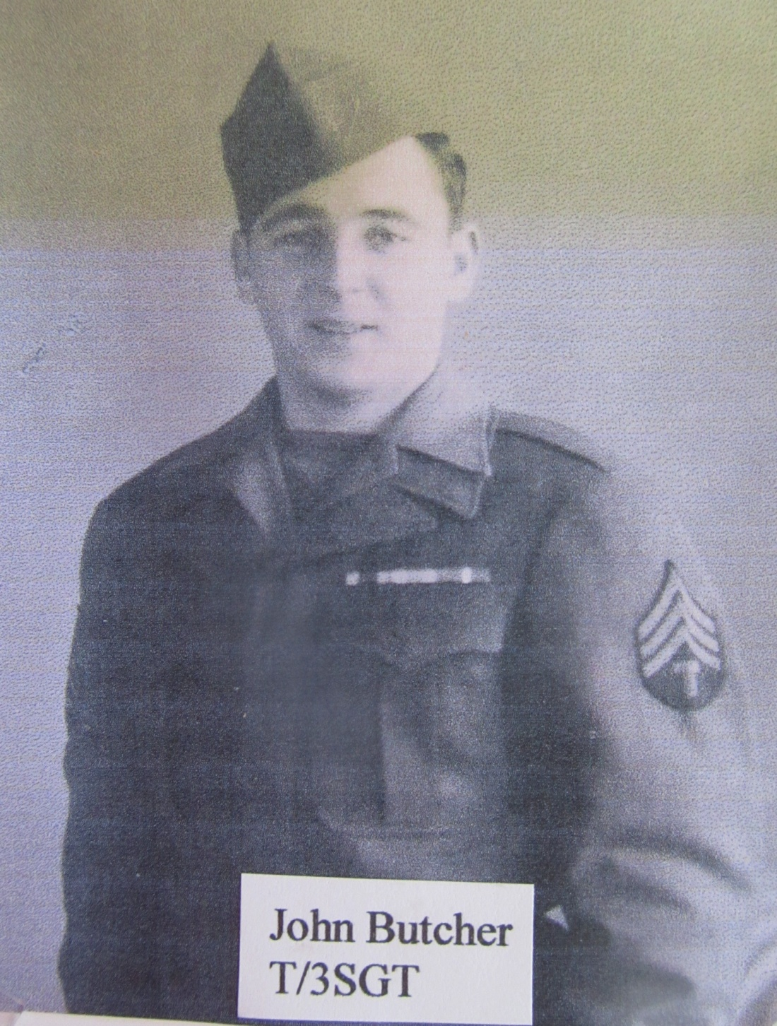

Slide 17
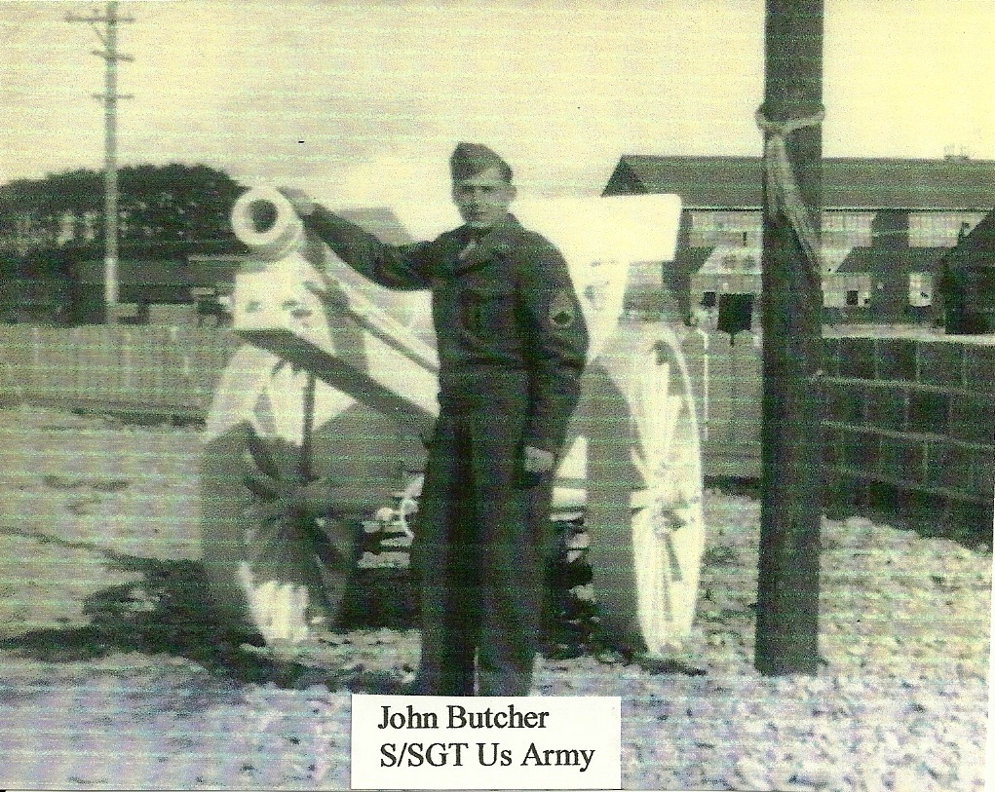

Slide 18
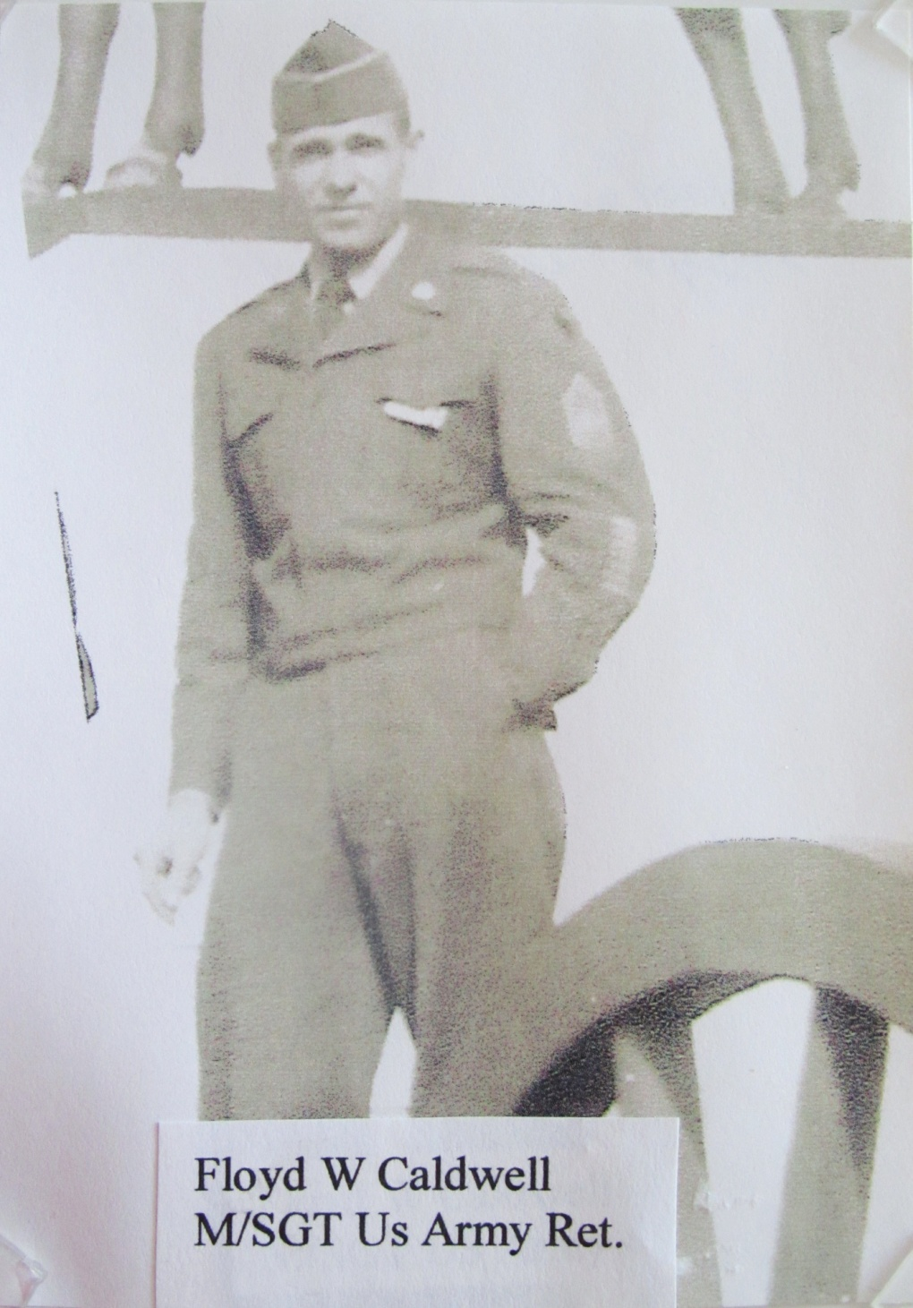

Slide 19
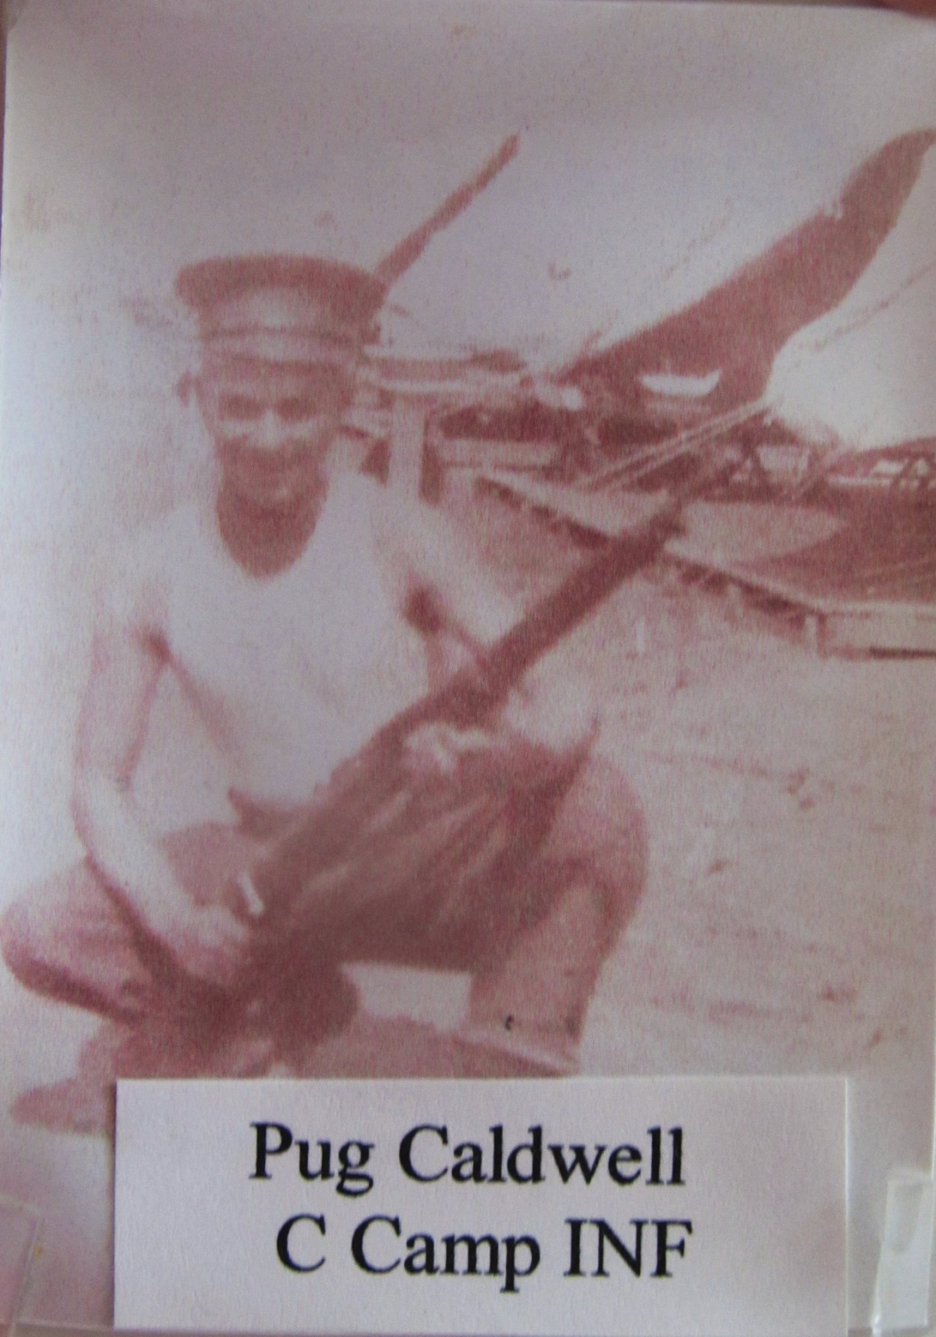

Slide 20
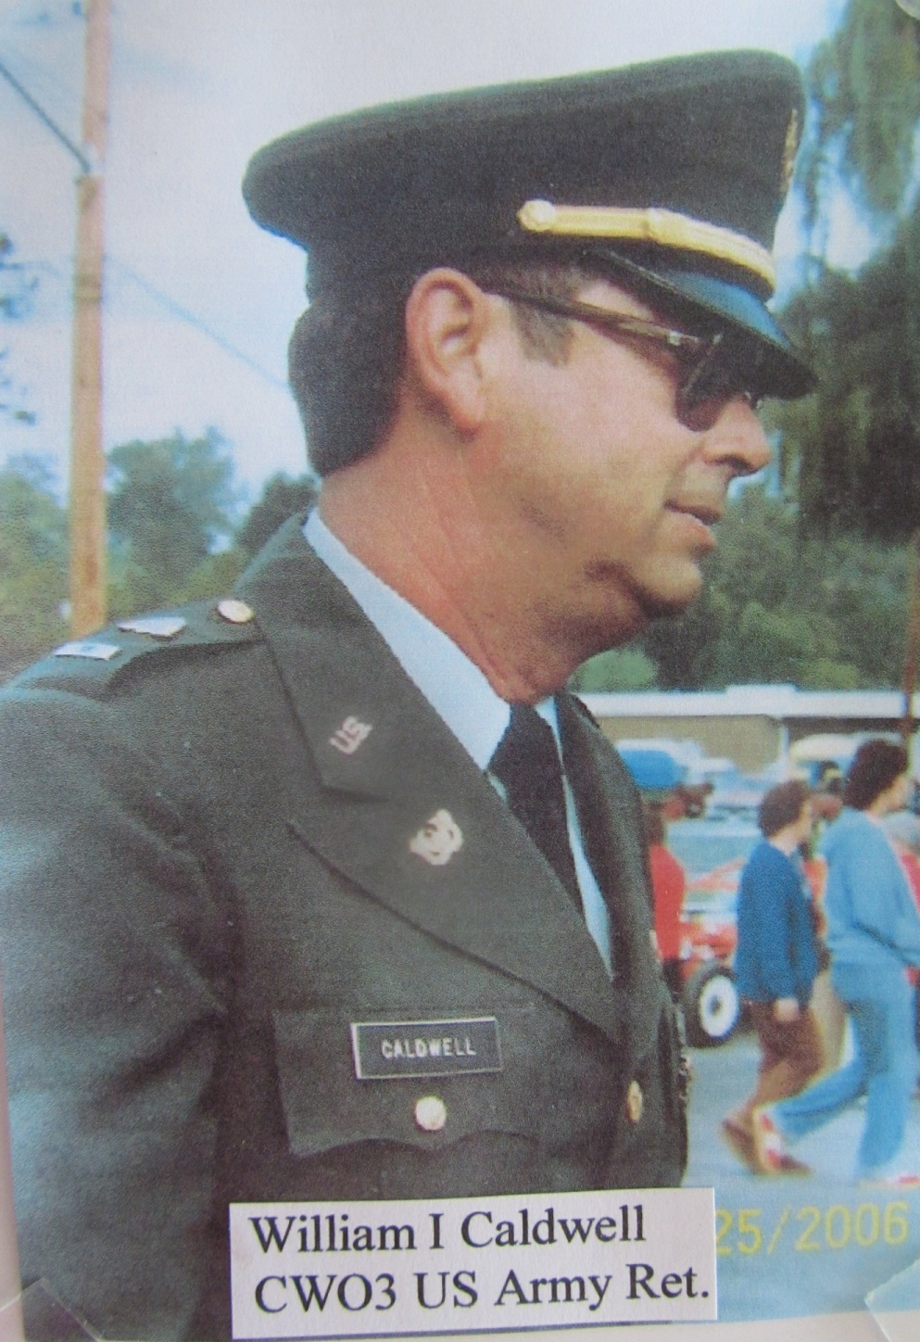

Slide 21
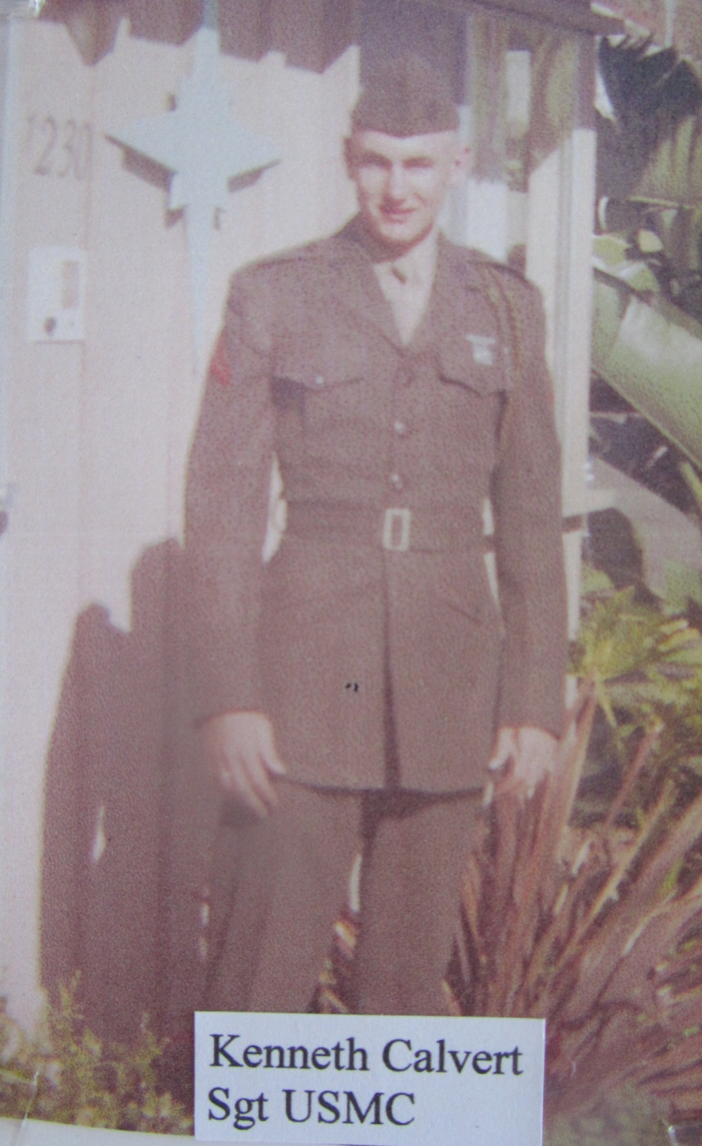
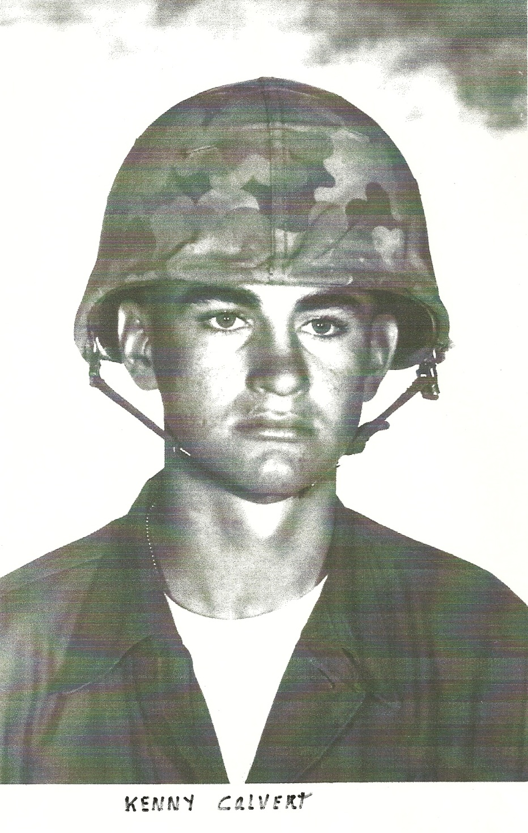

Slide 22
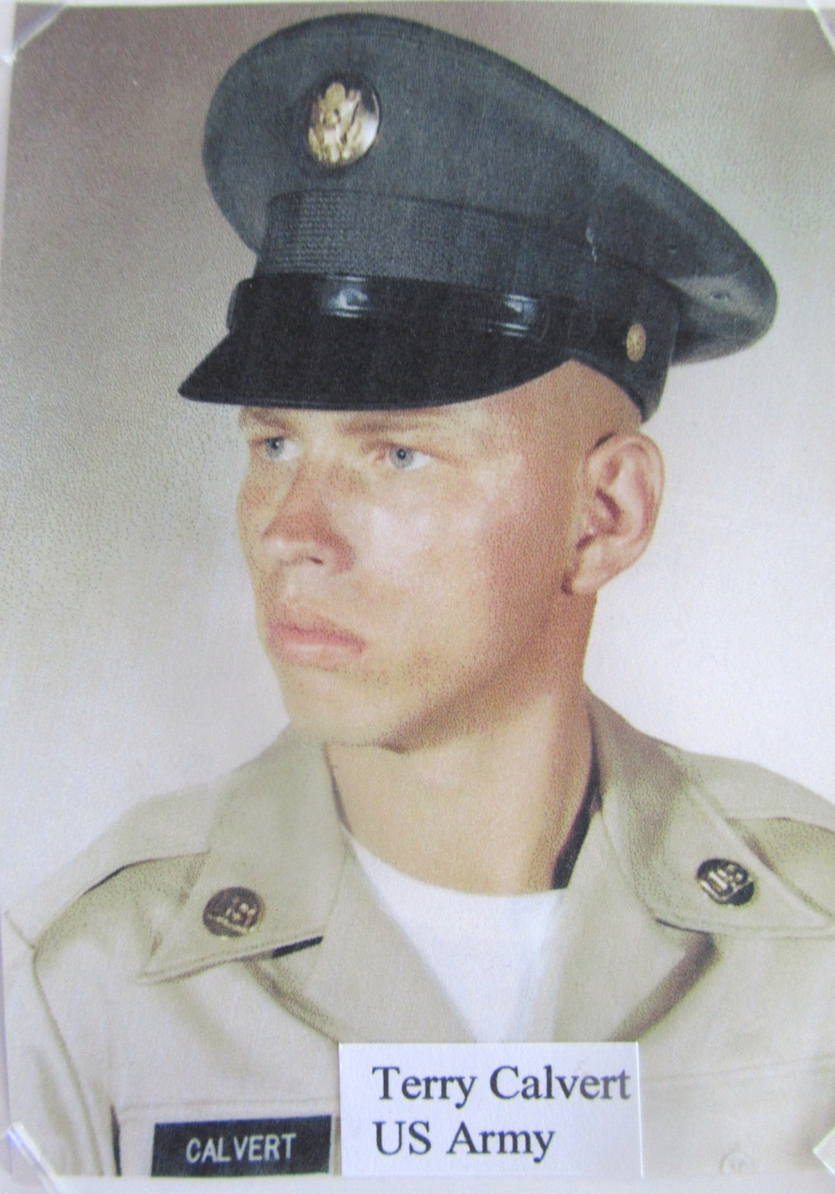

Slide 23
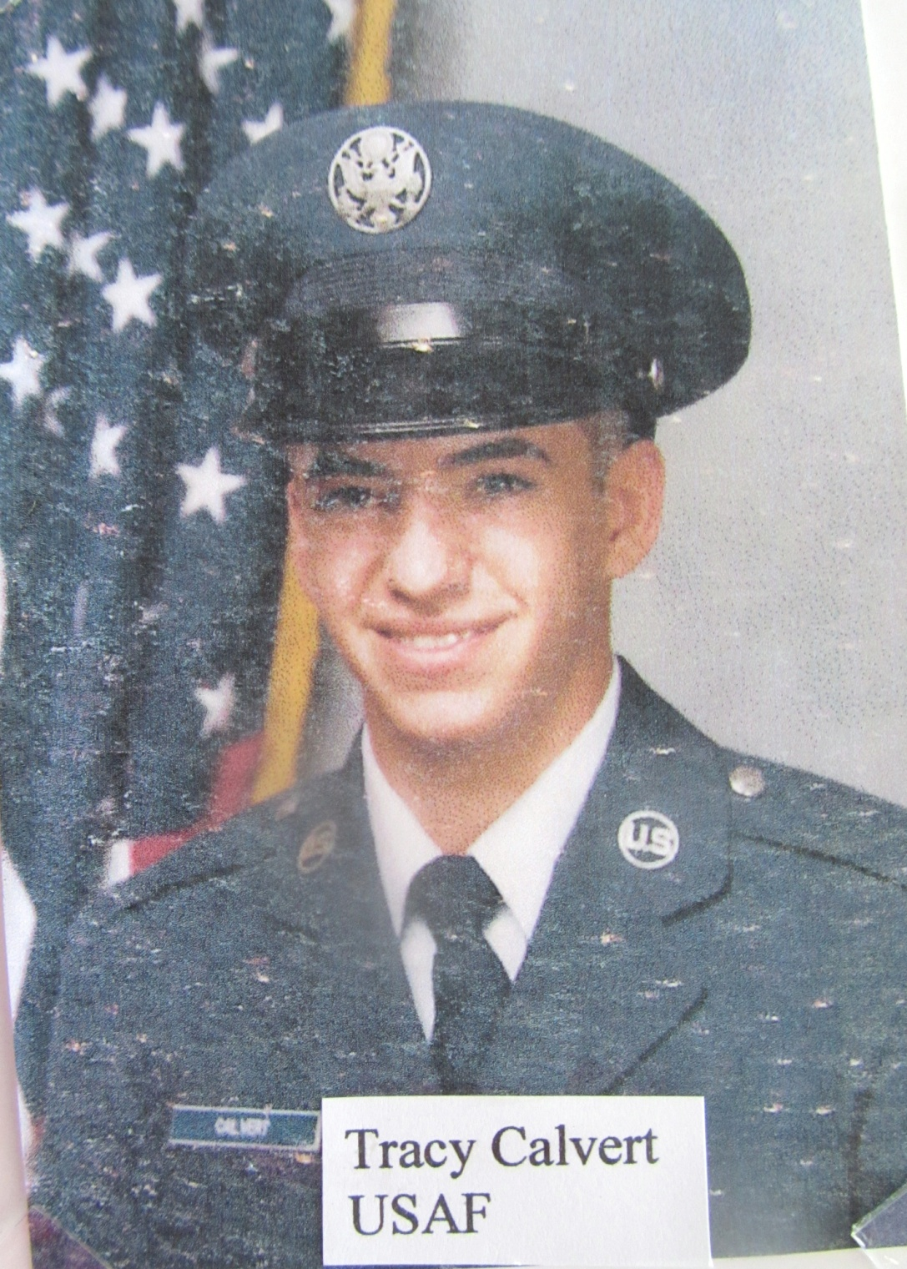

Slide 24
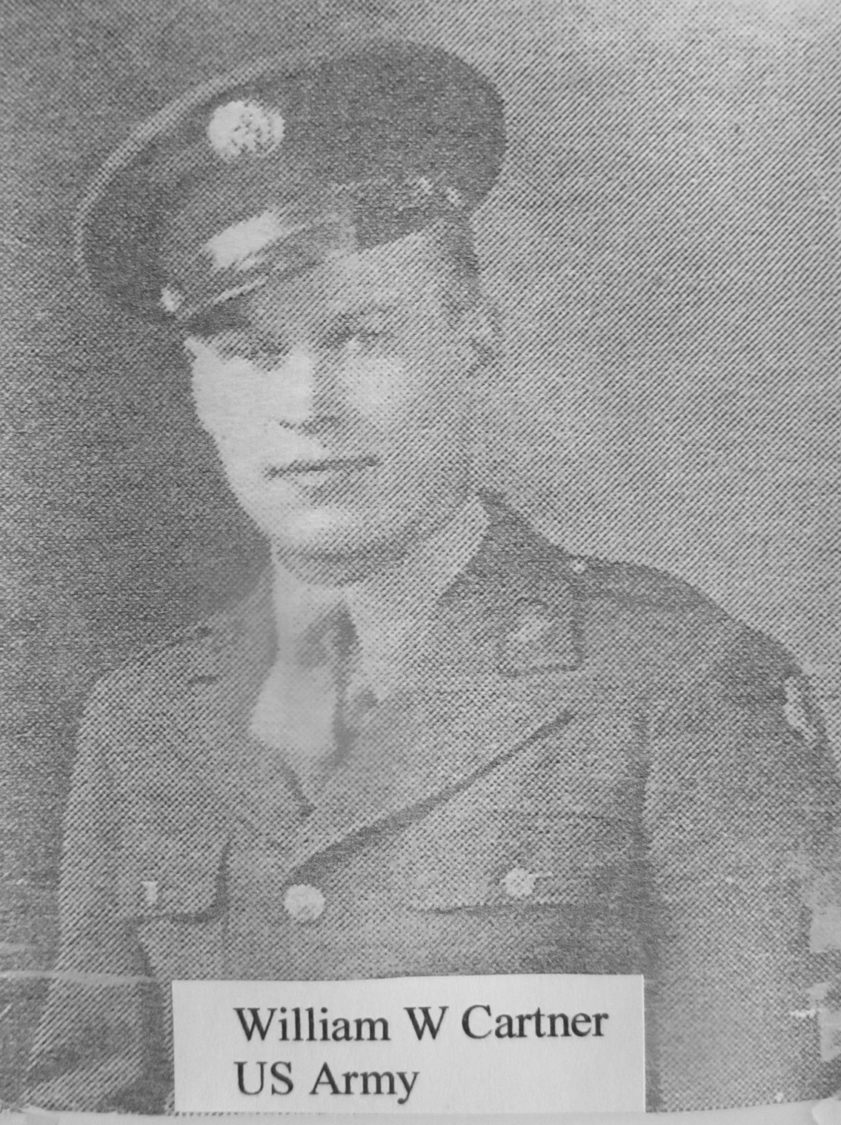

Slide 25
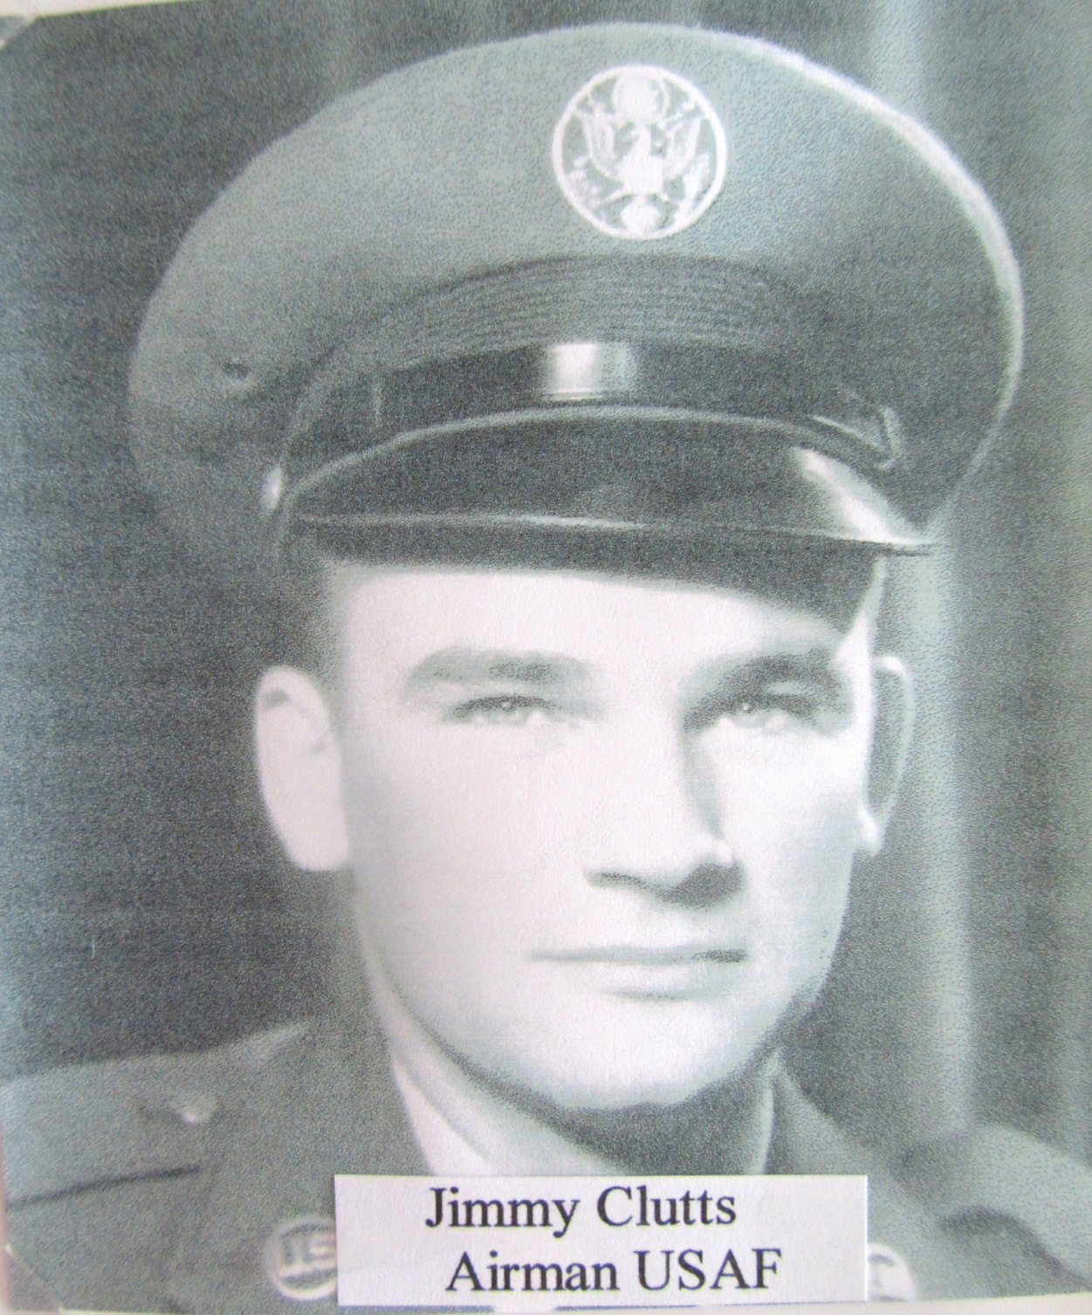

Slide 26
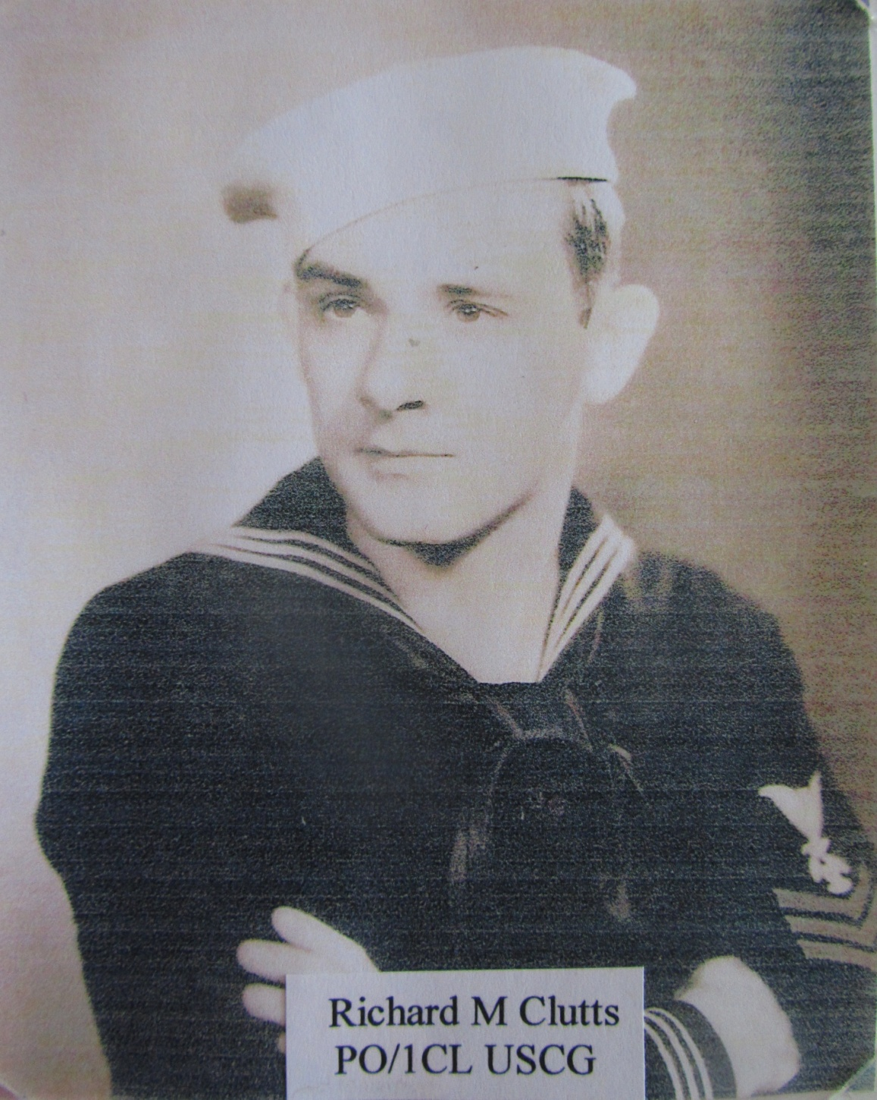

Slide 27
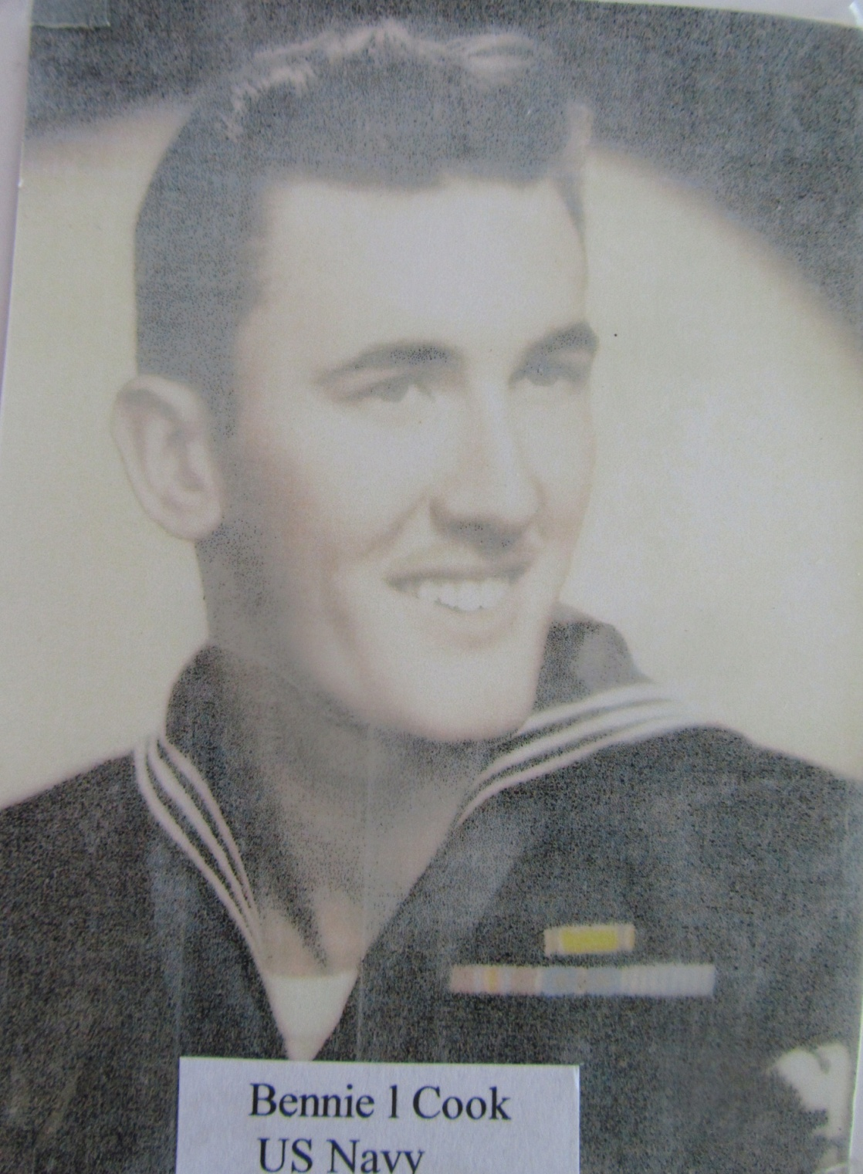

Slide 28
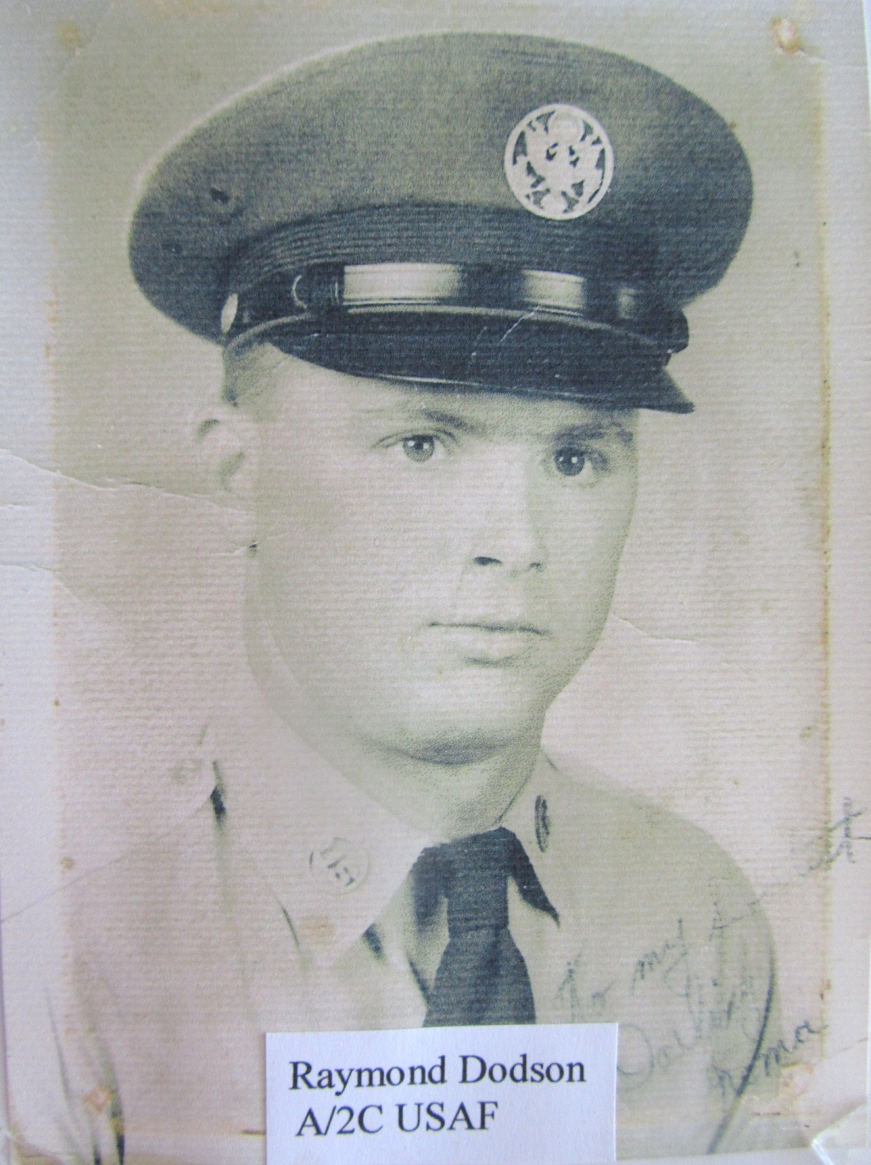

Slide 29
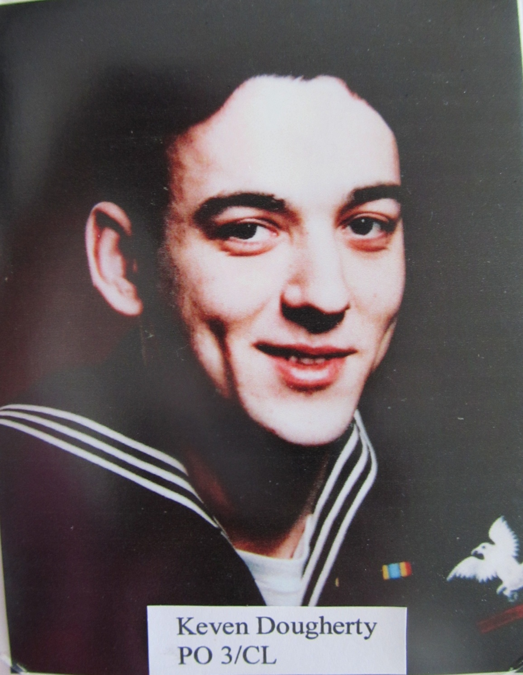

Slide 30
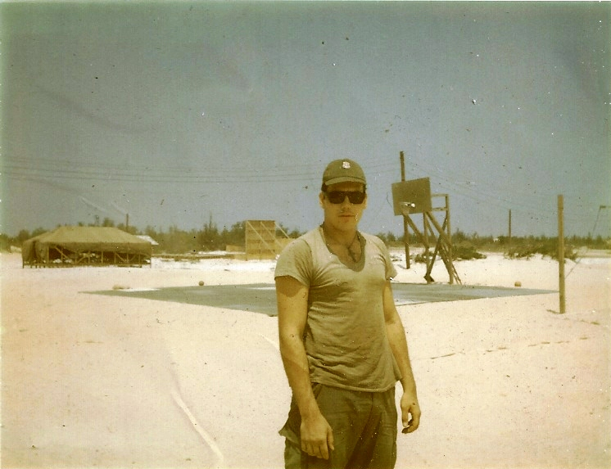
SP4 Larry Dunn
Vietnam, 1967

Slide 31
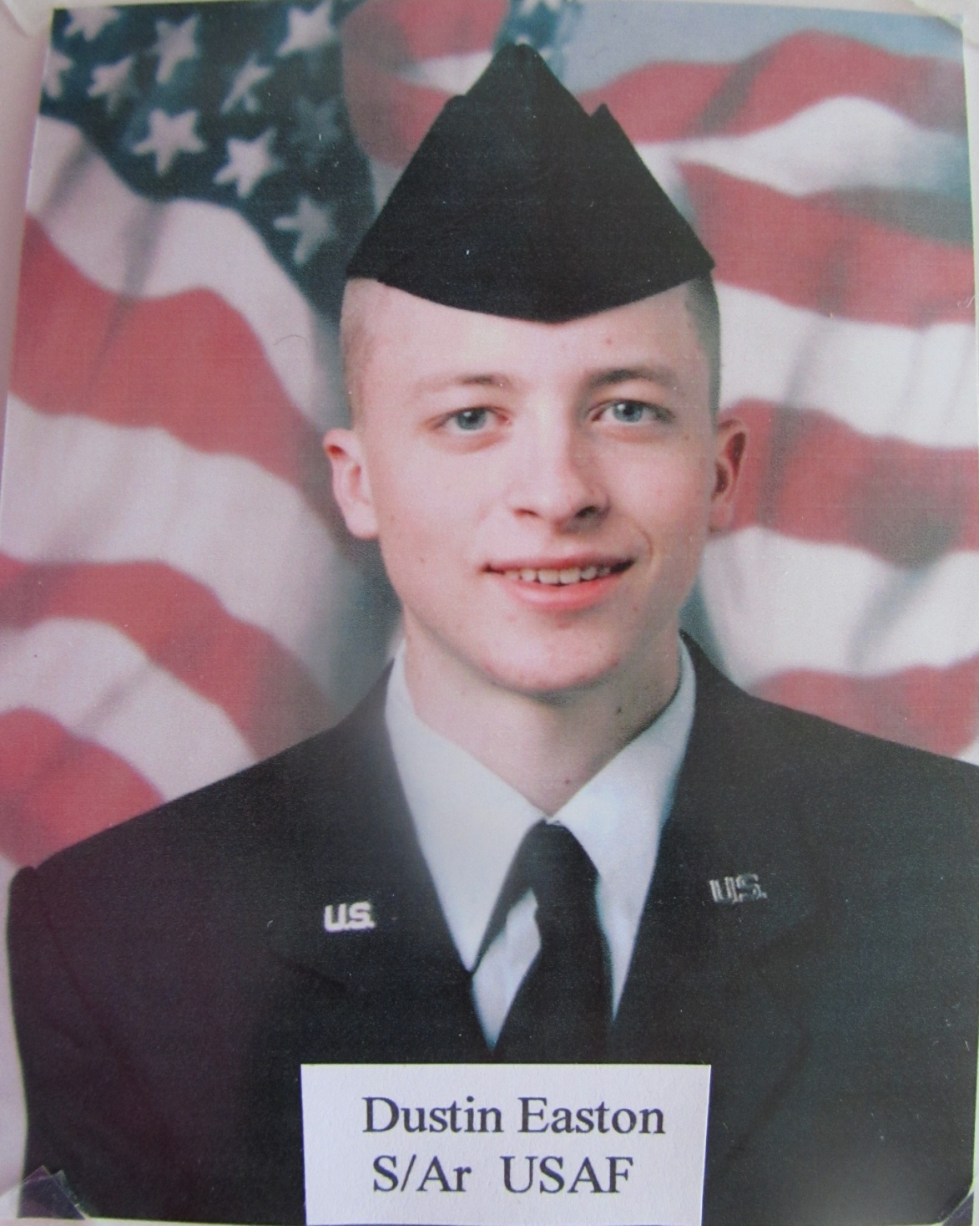

Slide 32
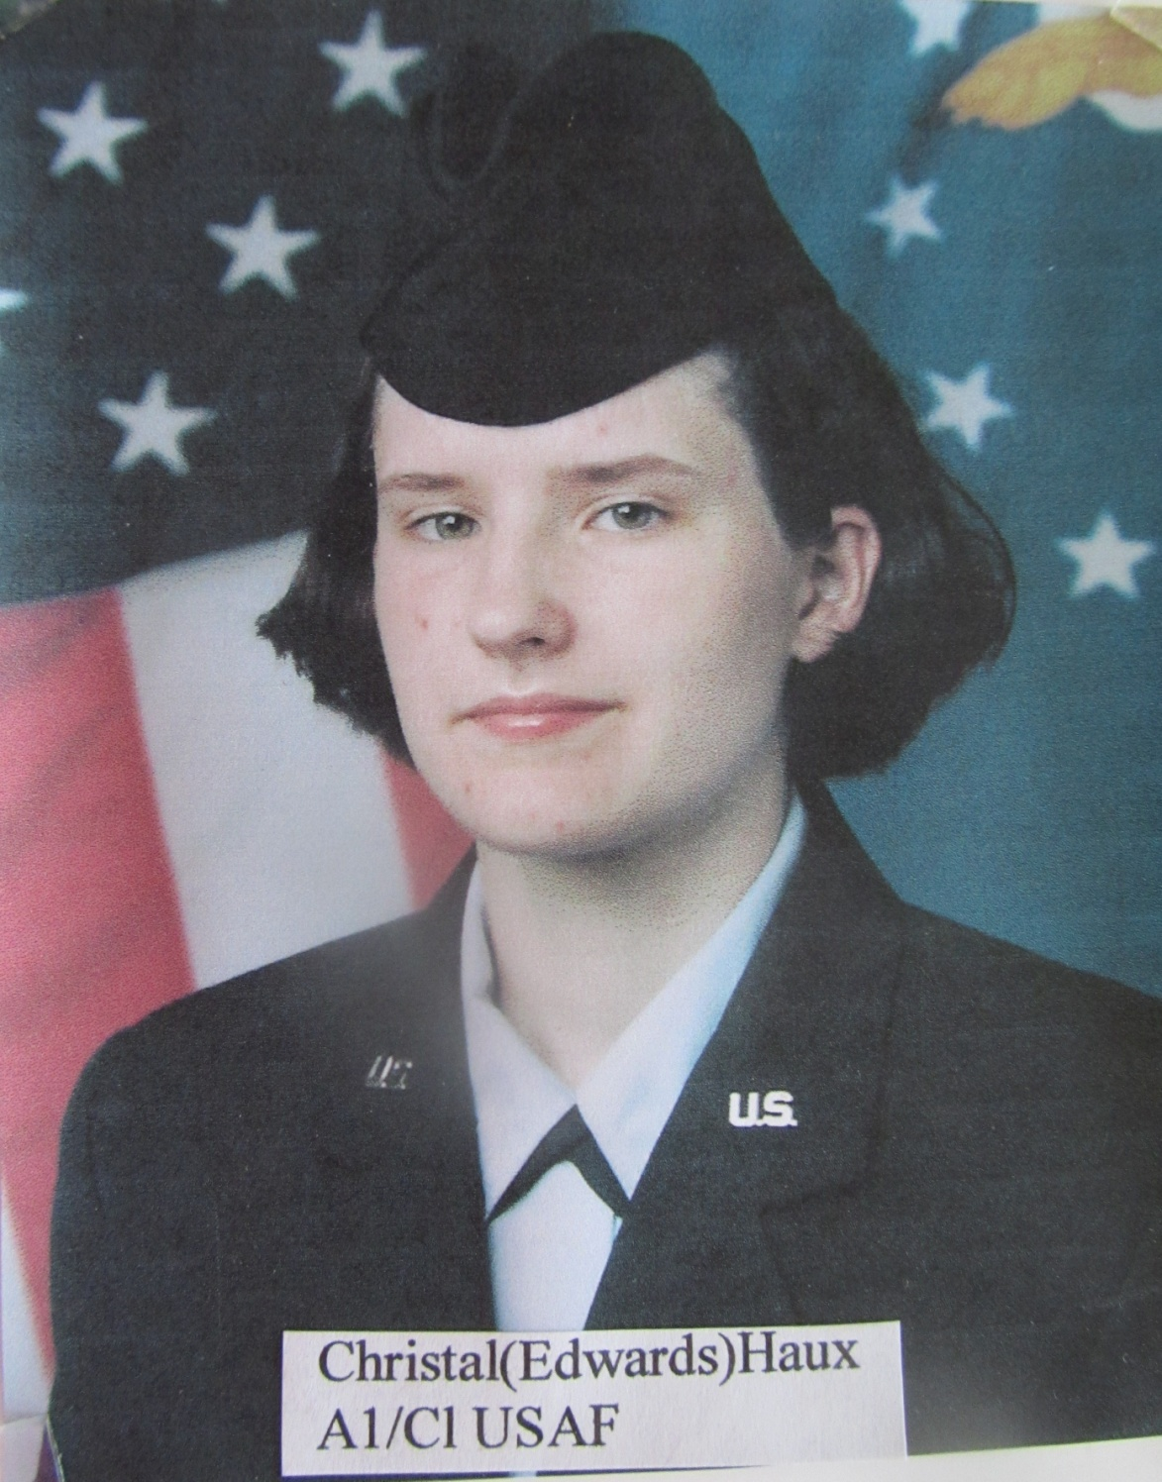

Slide 33
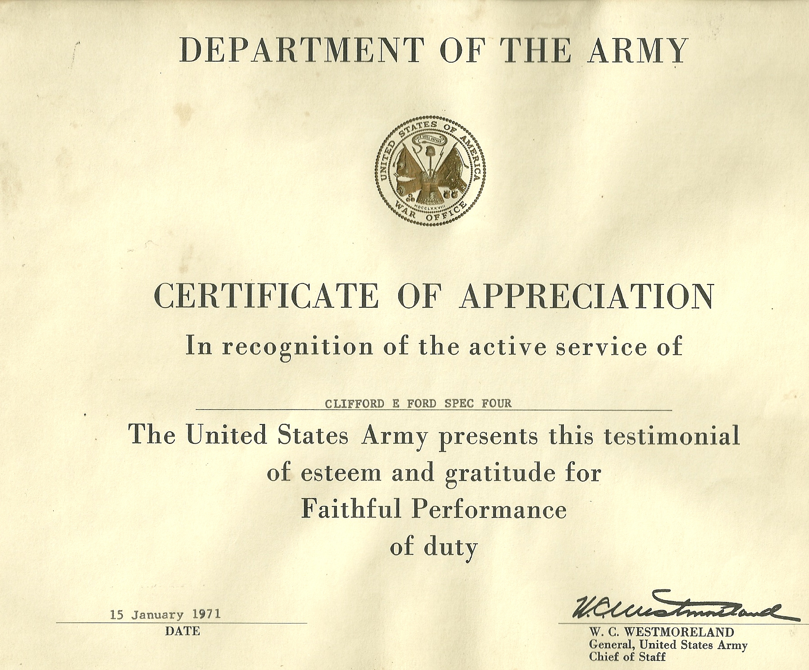

Slide 34
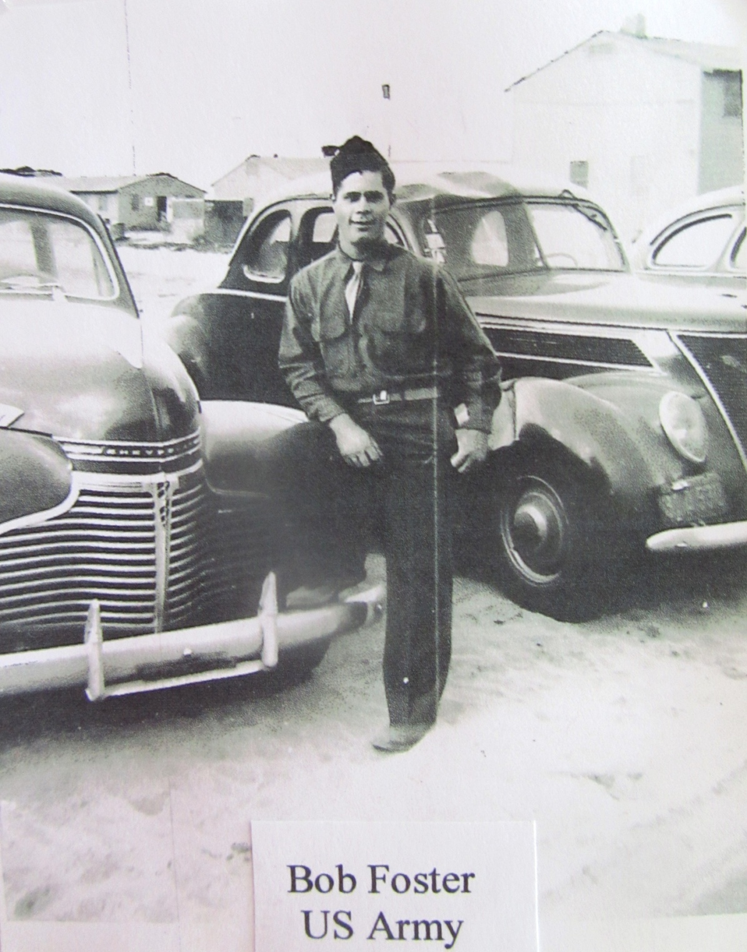

Slide 35
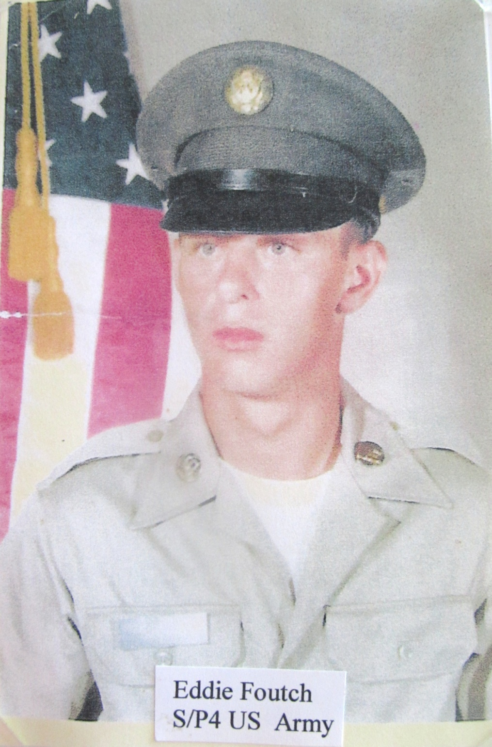

Slide 36
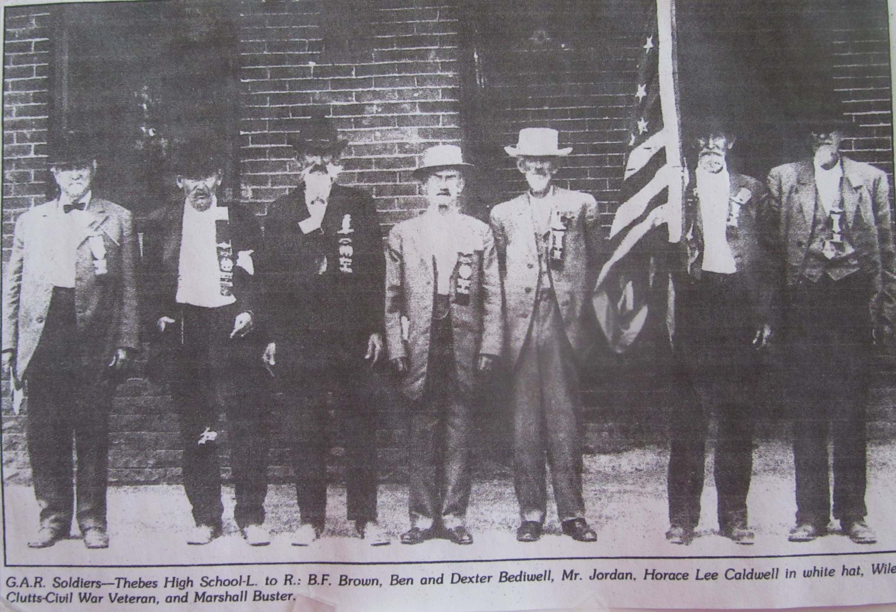

Slide 37
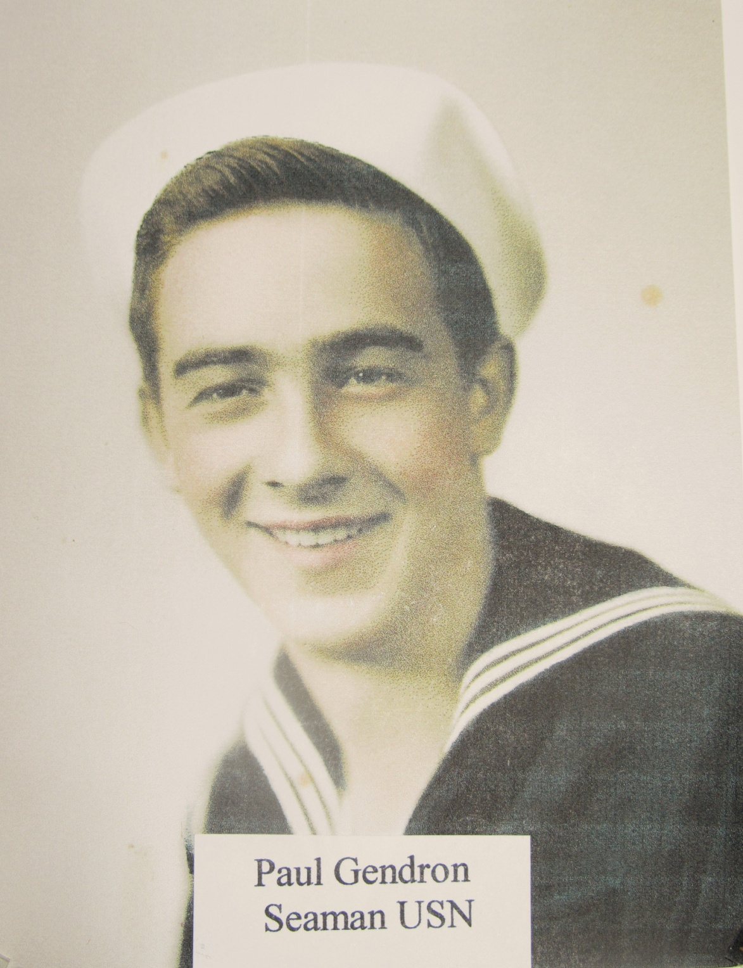

Slide 38
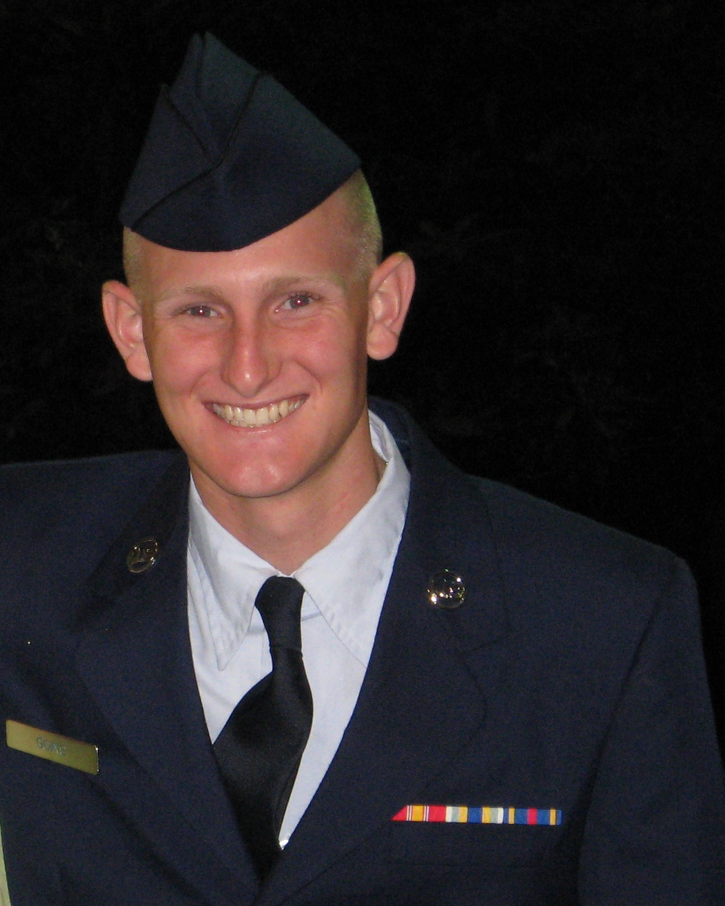
Cody Alan Goins, U.S. Air Force

Slide 39
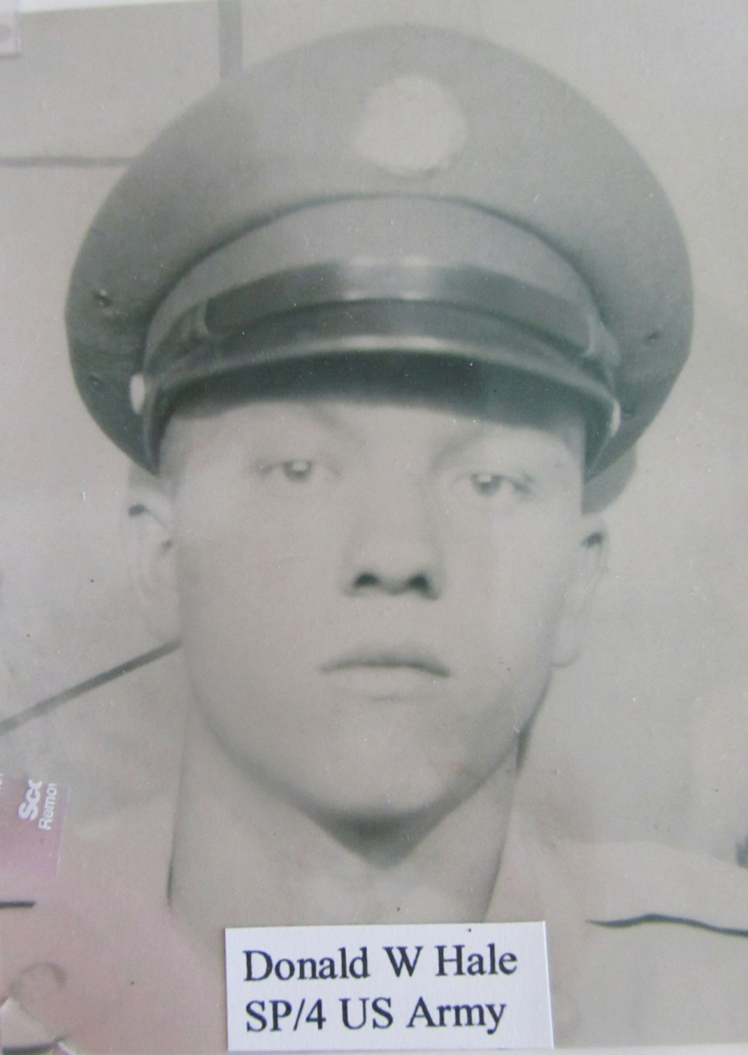

Slide 40
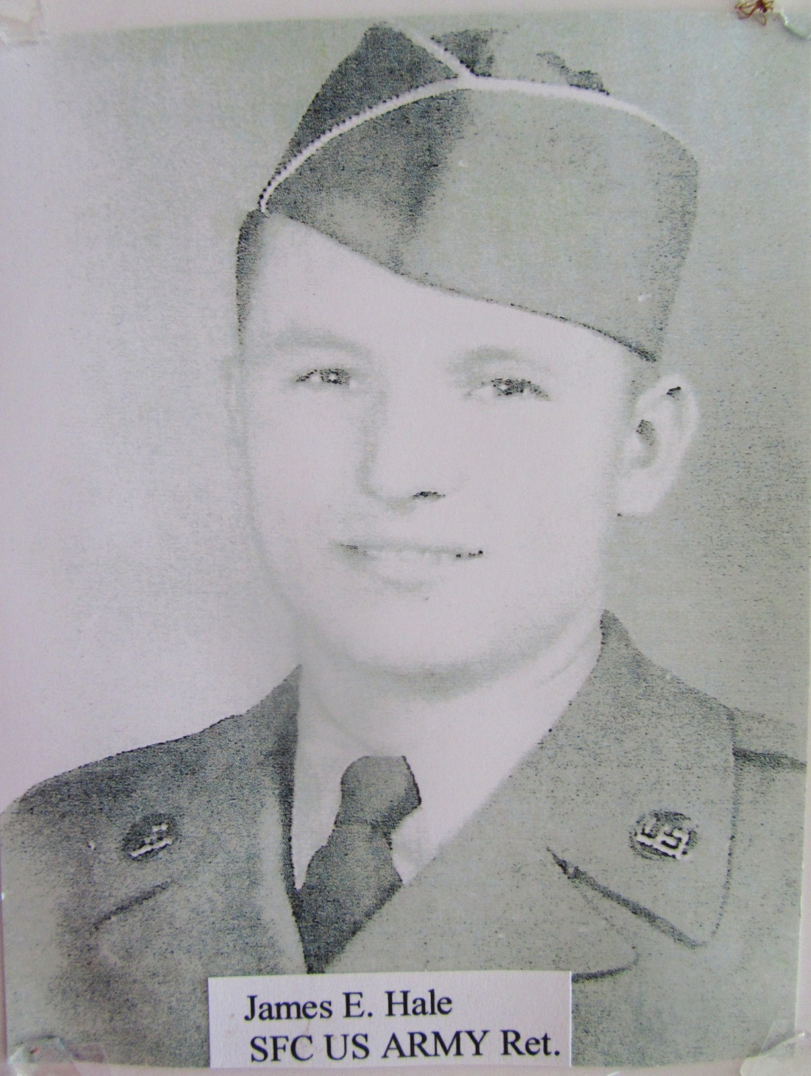

Slide 41
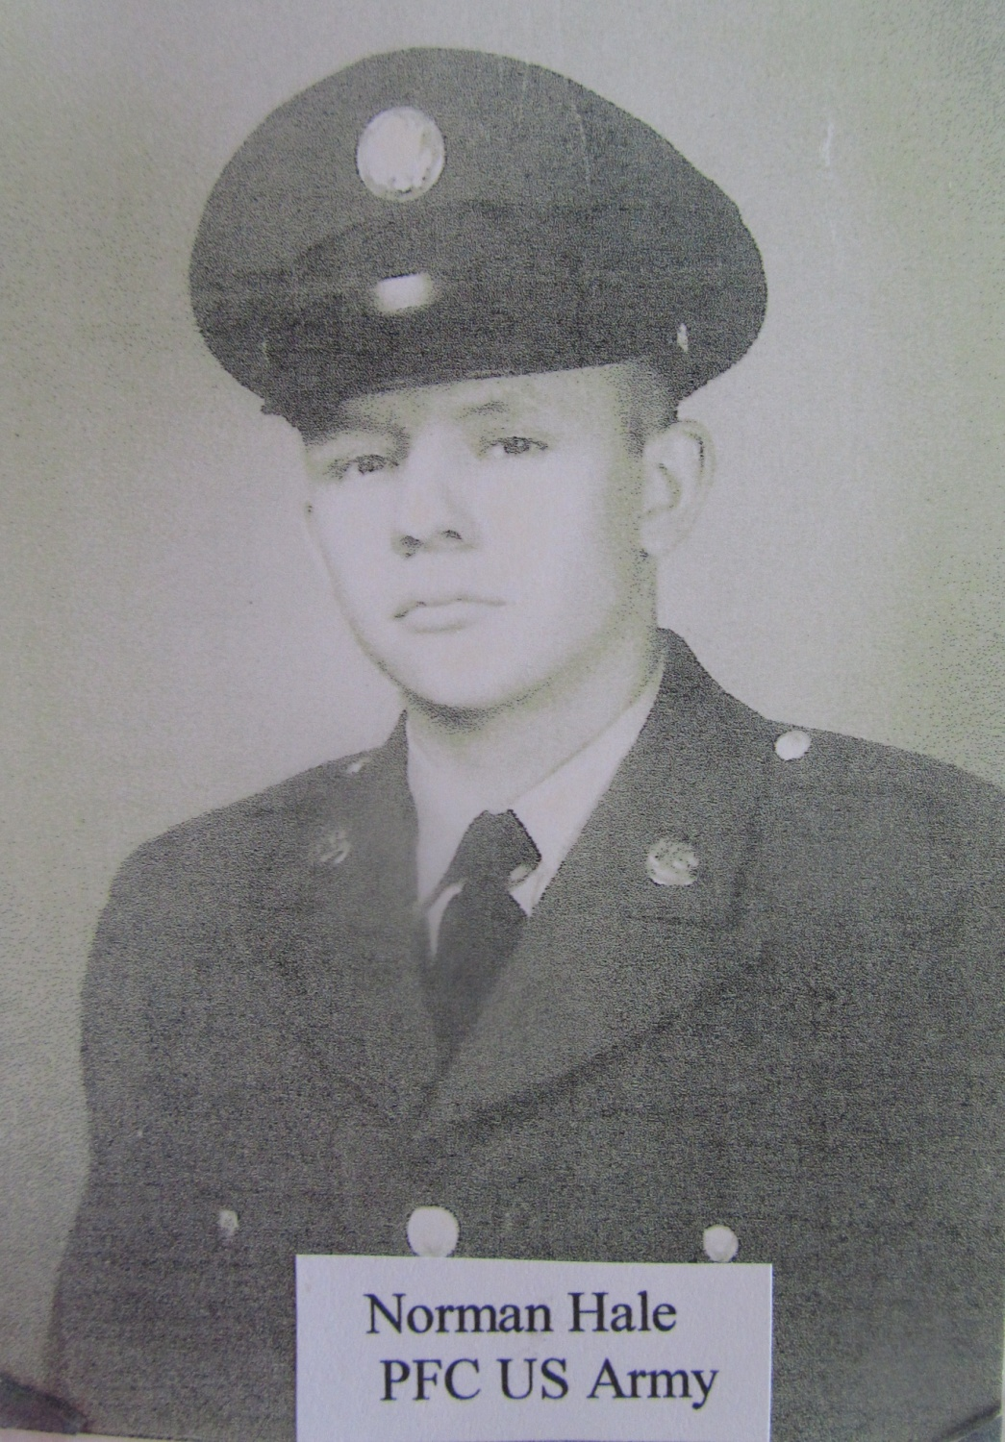

Slide 42
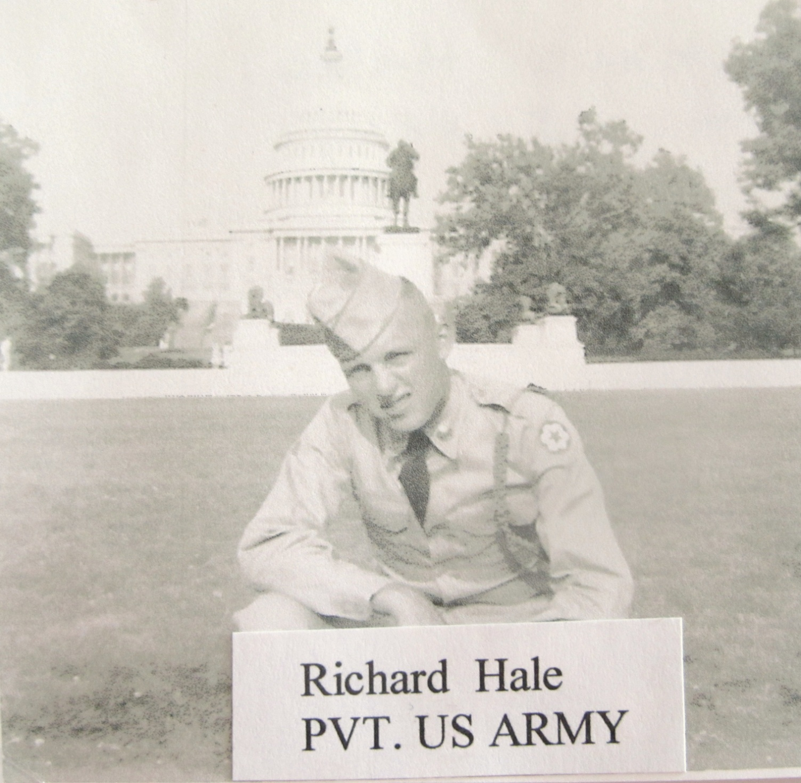

Slide 43
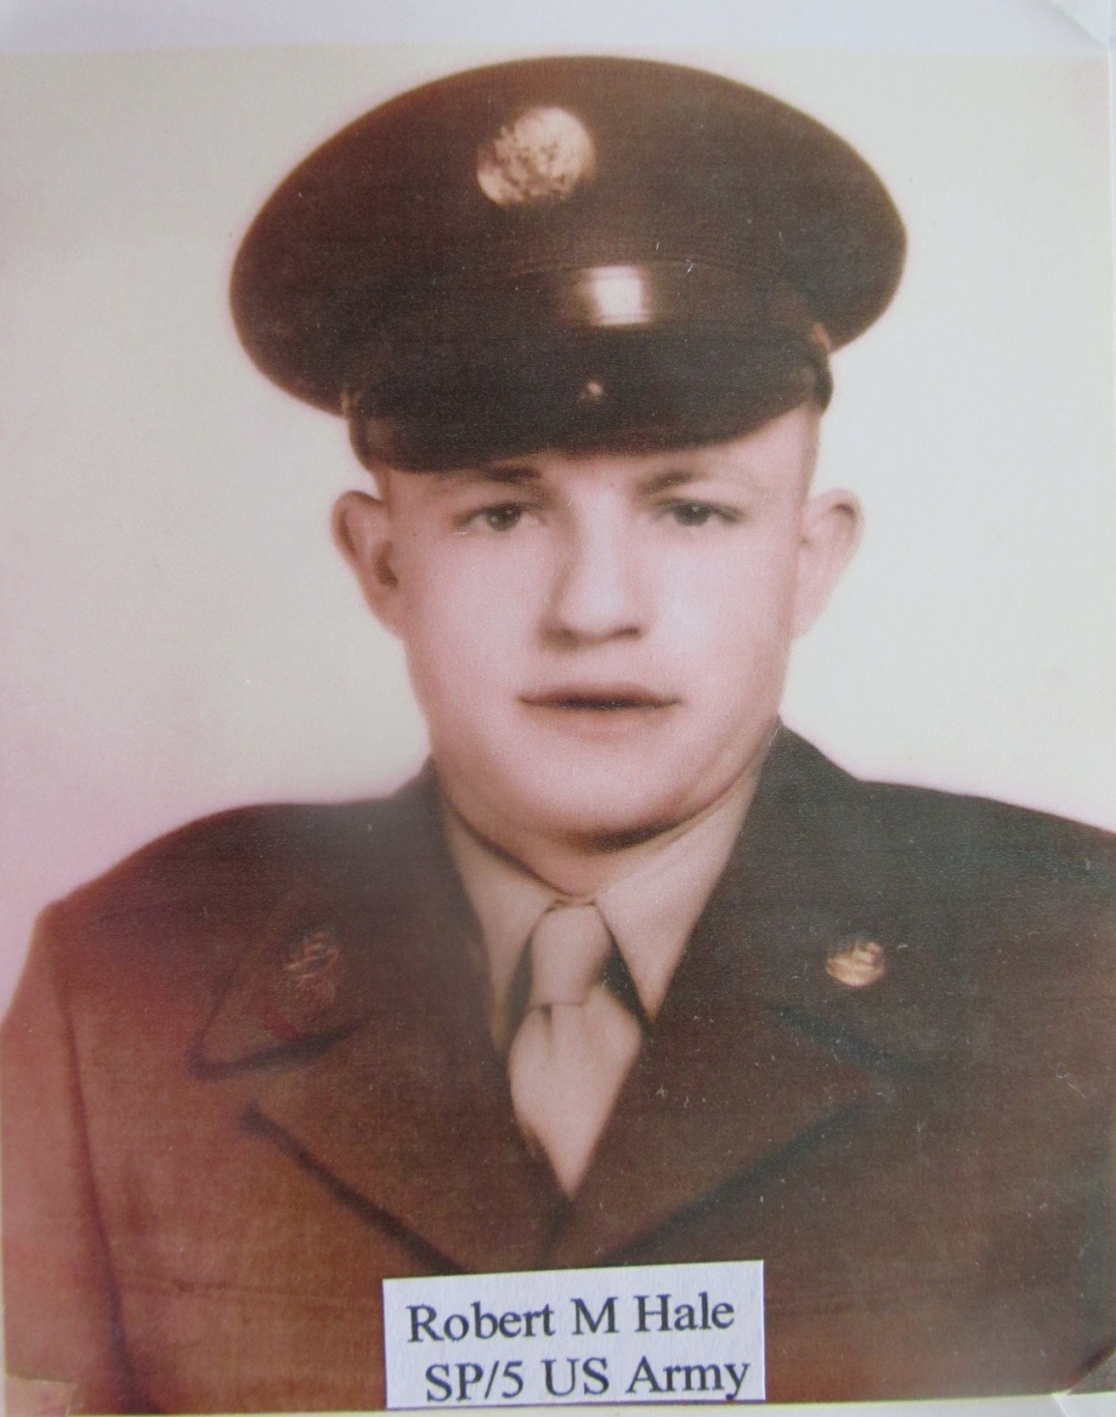

Slide 44
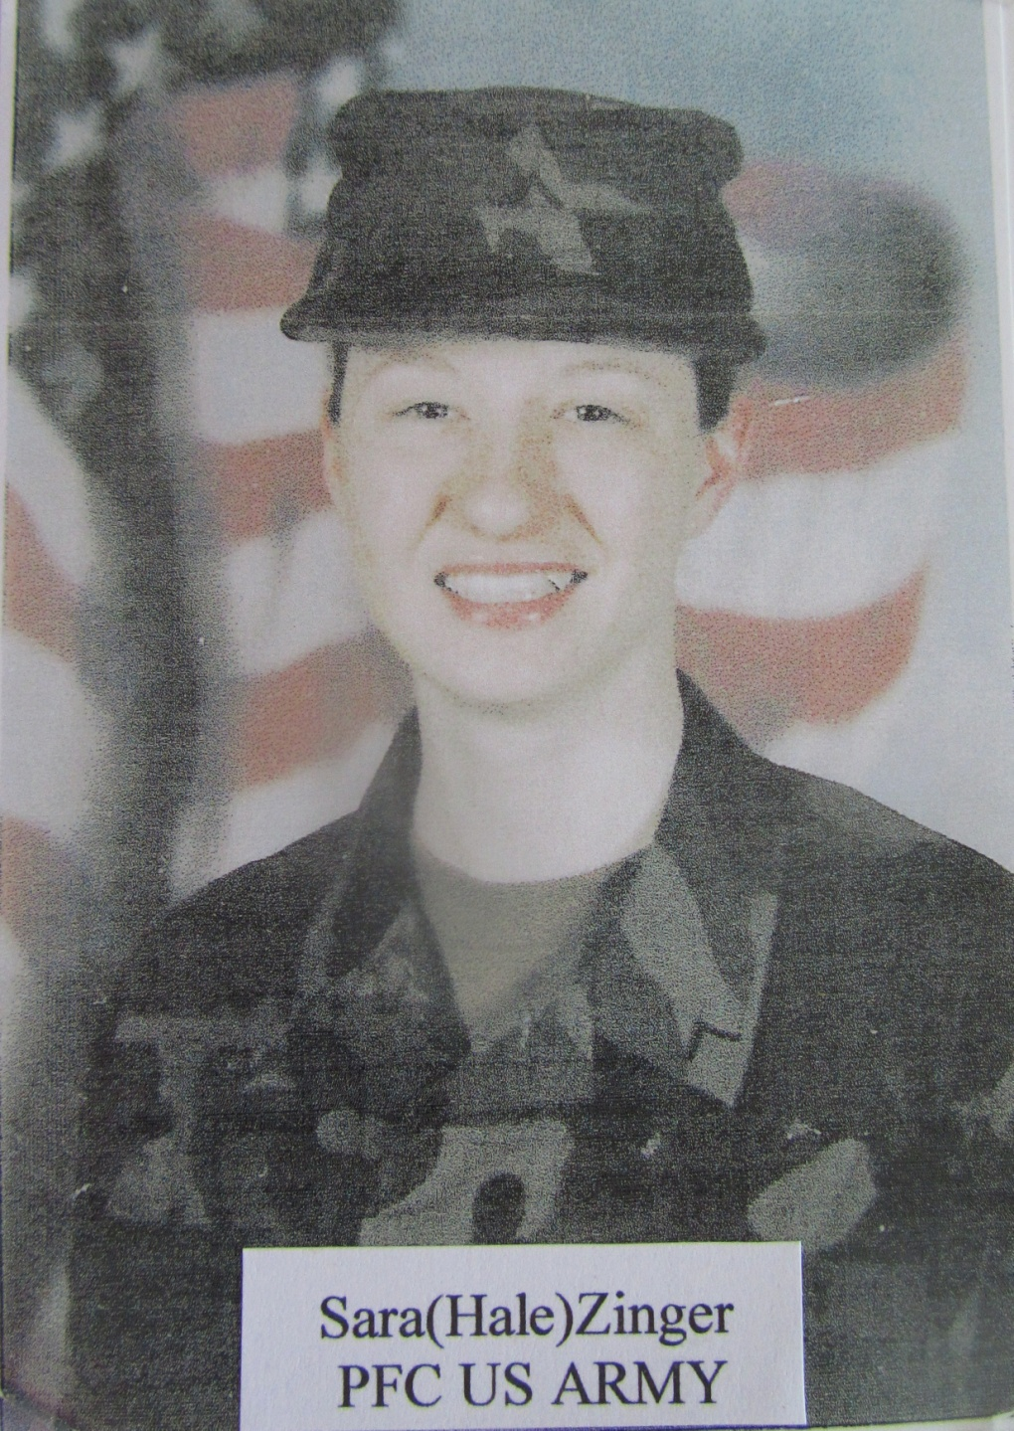

Slide 45
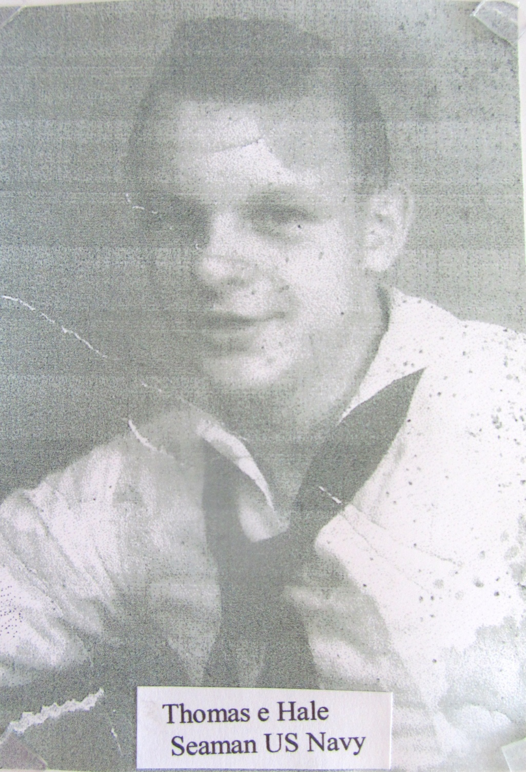

Slide 46
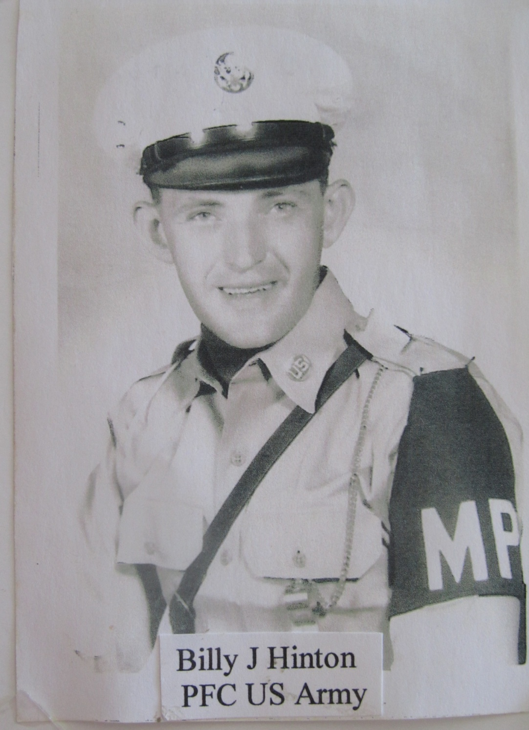

Slide 47
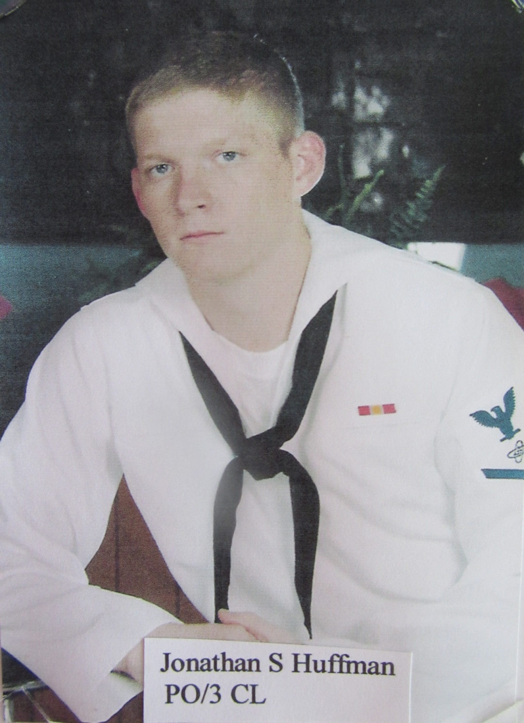

Slide 48
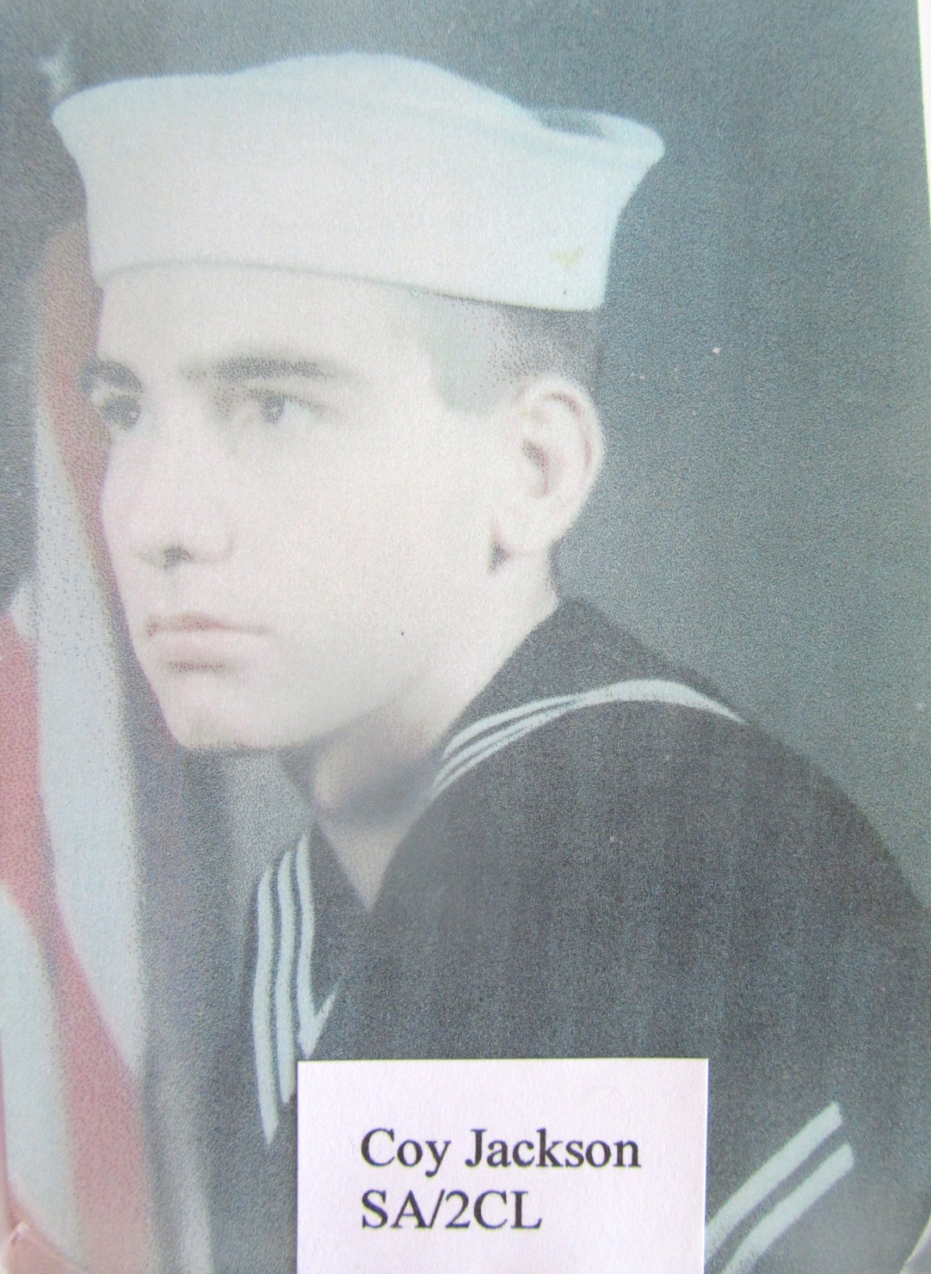

Slide 49
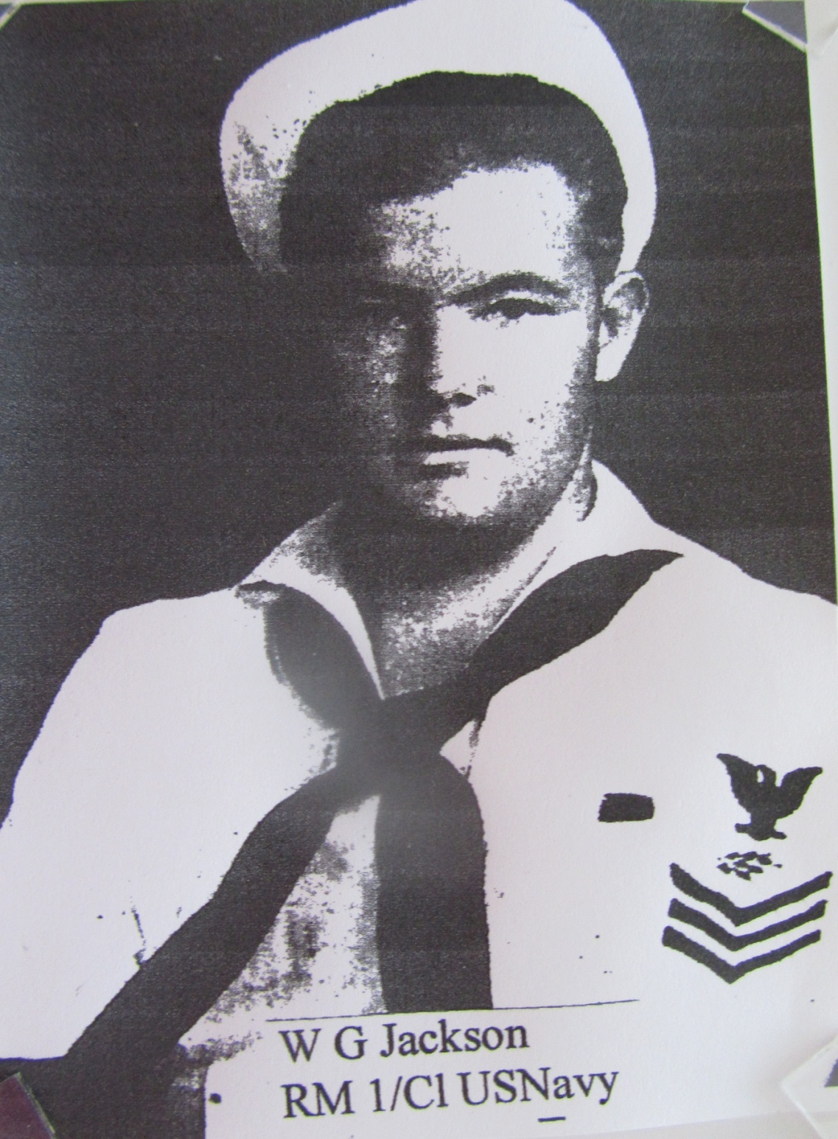

Slide 50
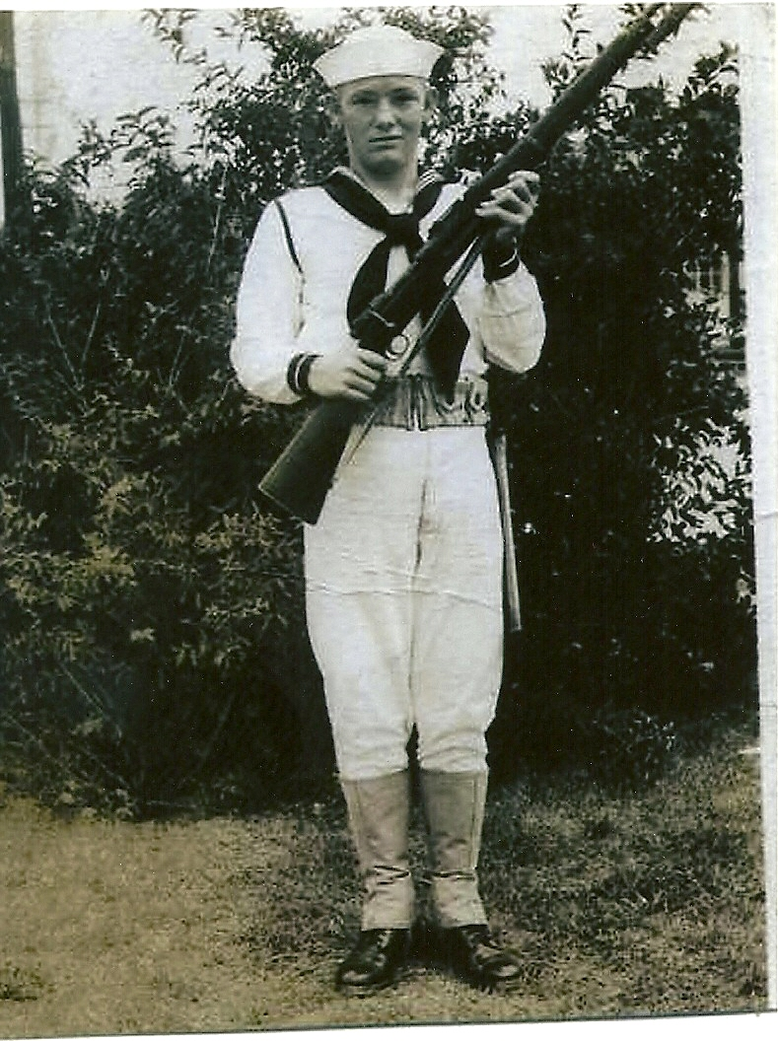
William Godfrey Macadoo Jackson (Mack)

Slide 53
Gregory L. Jordan
US Army 1977-80
Terry L. Jordan
US Army 1959-62
Larry Bruce Jordan
Retired US Army
Donald L. Jordan
Retired US Air Force
Vernard Mickey
Jordan WW II
and his sons…

Slide 54
Owen Meredith Kelley, WW I
1917

Slide 56
Ed King on left
Ed King, CCC

Slide 58
George Wayne King, d. 1944

Slide 61
Phillip Glen McCall, d. 1969
Vietnam War

Slide 68
Joseph Milton McNelly

Slide 79
P.E. Perkins
L. C. Sides

Slide 89
William Edward Scherer, WWII Army Air Corps

Slide 93
Louis L. Schlamer, WW II

Slide 94
Isaac Newton
& Allie Shafer
Their wedding
day in 1918

Slide 95
William Samuel (Billy) Shields
1973 Missing in Action

Slide 111
World War II

Slide 112
Purple Heart
Jack died in WW II

Slide 120
Betty Lou (Smiddy) and Roy Woodrow Waddell, 1942

Slide 125
Brandon Kyle Wareing
U.S. Air Force

Slide 126
Bruce Wareing

Slide 127
Paul Martin Wareing

Slide 133
Loren Wilson
James Wilson

Slide 138
We remember our fallen heroes.

Slide 139
Thebes Historical Society
www.thebescourthouse.com
May 2012

